Slide 1
Module -1

Slide 2
Big Data Analytics
Big data analytics is the process of collecting, examining, and analyzing large amounts of data to discover market trends, insights, and patterns that can help companies make better business decisions.
This information is available quickly and efficiently so that companies can be agile in crafting plans to maintain their competitive advantage.
Technologies such as business intelligence (BI) tools and systems help organizations take the unstructured and structured data from multiple sources.
Users (typically employees) input queries into these tools to understand business operations and performance. Big data analytics uses the four data analysis methods to uncover meaningful insights and derive solutions.

Slide 3
Example of big data analytics
For example, big data analytics is integral to the modern health care industry.
As you can imagine, thousands of patient records, insurance plans, prescriptions, and vaccine information need to be managed.
It comprises huge amounts of structured and unstructured data, which can offer important insights when analytics are applied.
Big data analytics does this quickly and efficiently so that health care providers can use the information to make informed, life-saving diagnoses.

Slide 4
Types of Big Data Analytics
1. Descriptive analytics
Descriptive analytics refers to data that can be easily read and interpreted. This data helps create reports and visualize information that can detail company profits and sales.
Example: During the pandemic, a leading pharmaceuticals company conducted data analysis on its offices and research labs. Descriptive analytics helped them identify unutilized spaces and departments that were consolidated, saving the company millions of dollars.

Slide 5
2. Diagnostics analytics
Diagnostics analytics helps companies understand why a problem occurred. Big data technologies and tools allow users to mine and recover data that helps dissect an issue and prevent it from happening in the future.
Example: A clothing company’s sales have decreased even though customers continue to add items to their shopping carts. Diagnostics analytics helped to understand that the payment page was not working properly for a few weeks.

Slide 6
Predictive analytics
Predictive analytics looks at past and present data to make predictions. With artificial intelligence (AI), machine learning, and data mining, users can analyze the data to predict market trends.
Example: In the manufacturing sector, companies can use algorithms based on historical data to predict if or when a piece of equipment will malfunction or break down.

Slide 7
4. Prescriptive analytics
Prescriptive analytics provides a solution to a problem, relying on AI and machine learning to gather data and use it for risk management.
Example: Within the energy sector, utility companies, gas producers, and pipeline owners identify factors that affect the price of oil and gas in order to hedge risks.

Slide 8

Types of Big Data

Slide 9
Structured Data
Structured data can be crudely defined as the data that resides in a fixed field within a record.
It is type of data most familiar to our everyday lives. for ex: birthday,address
A certain schema binds it, so all the data has the same set of properties. Structured data is also called relational data. It is split into multiple tables to enhance the integrity of the data by creating a single record to depict an entity. Relationships are enforced by the application of table constraints.
The business value of structured data lies within how well an organization can utilize its existing systems and processes for analysis purposes.

Slide 10
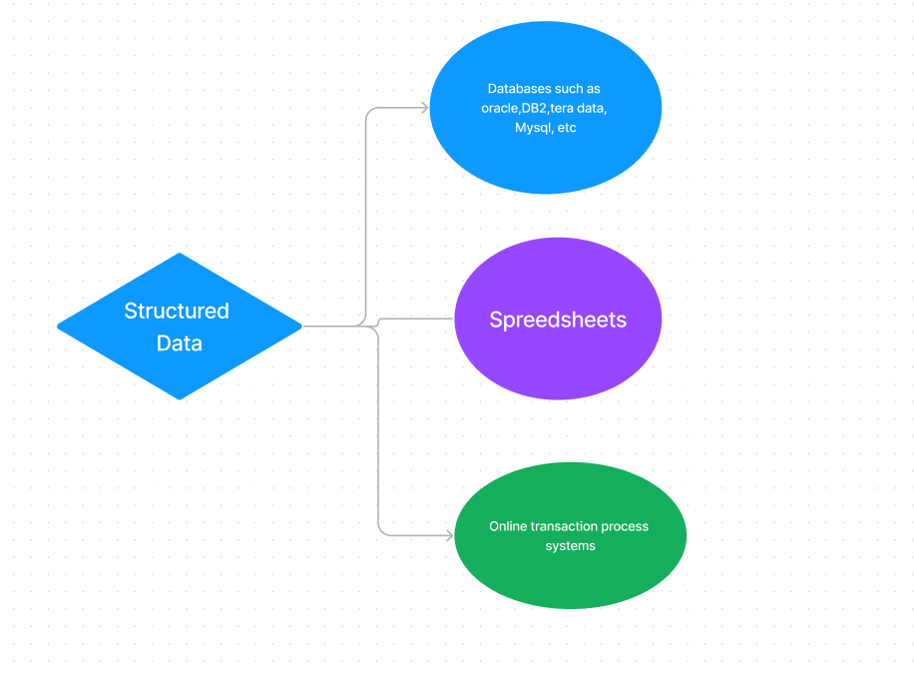

Slide 11
A Structured Query Language (SQL) is needed to bring the data together. Structured data is easy to enter, query, and analyze.
All of the data follows the same format. However, forcing a consistent structure also means that any alteration of data is too tough as each record has to be updated to adhere to the new structure.
Examples of structured data include numbers, dates, strings, etc. The business data of an e-commerce website can be considered to be structured data.

Slide 12
Name | Class | Section | Roll No | Grade
Geek1 | 11 | A | 1 | A
Geek2 | 11 | A | 2 | B
Geek3 | 11 | A | 3 | A

Slide 13
Semi-Structured Data
Semi-structured data is not bound by any rigid schema for data storage and handling. The data is not in the relational format and is not neatly organized into rows and columns like that in a spreadsheet.
However, there are some features like key-value pairs that help in discerning the different entities from each other.
Since semi-structured data doesn’t need a structured query language, it is commonly called NoSQL data.

Slide 14
A data serialization language is used to exchange semi-structured data across systems that may even have varied underlying infrastructure.
Semi-structured content is often used to store metadata about a business process but it can also include files containing machine instructions for computer programs.
This type of information typically comes from external sources such as social media platforms or other web-based data feeds.

Slide 15
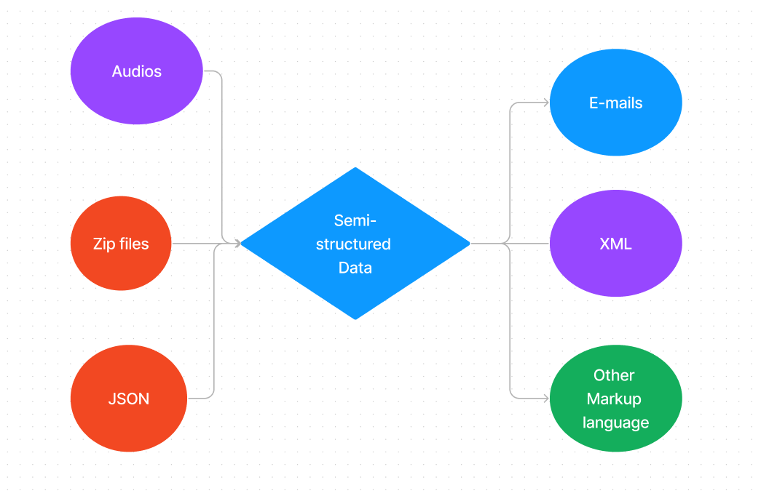

Slide 16
Unstructured Data
Unstructured data is the kind of data that doesn’t adhere to any definite schema or set of rules. Its arrangement is unplanned and haphazard.
Photos, videos, text documents, and log files can be generally considered unstructured data. Even though the metadata accompanying an image or a video may be semi-structured, the actual data being dealt with is unstructured.
Additionally, Unstructured data is also known as “dark data” because it cannot be analyzed without the proper software tools.

Slide 17
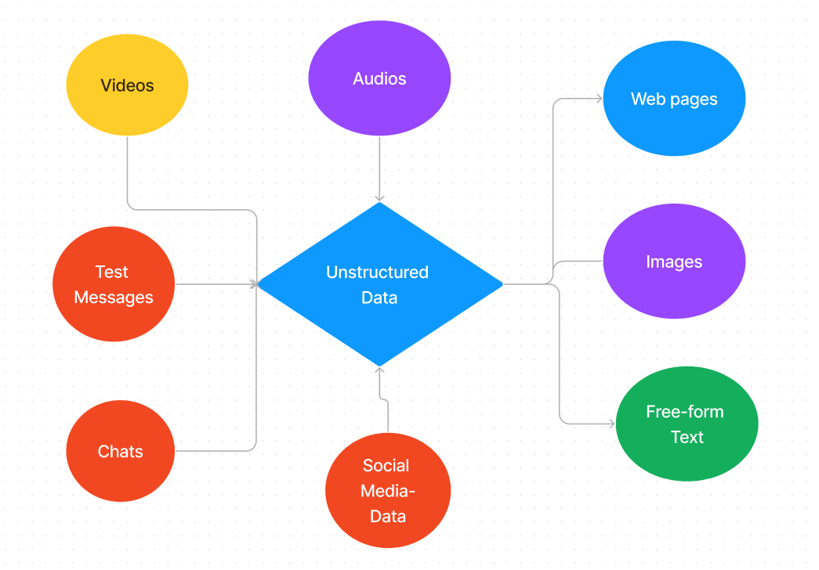

Slide 18
Big Data Characteristics
5 V's of Big Data
Volume
Veracity
Variety
Value
Velocity

Slide 19
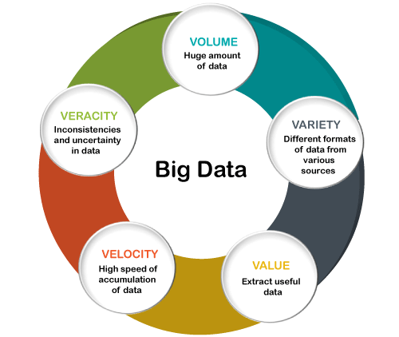

Slide 20
Volume
The name Big Data itself is related to an enormous size. Big Data is a vast 'volumes' of data generated from many sources daily, such as business processes, machines, social media platforms, networks, human interactions, and many more.
Facebook can generate approximately a billion messages, 4.5 billion times that the "Like" button is recorded, and more than 350 million new posts are uploaded each day. Big data technologies can handle large amounts of data.

Slide 21
Variety
Big Data can be structured, unstructured, and semi-structured that are being collected from different sources.
Data will only be collected from databases and sheets in the past, But these days the data will comes in array forms, that are PDFs, Emails, audios, SM posts, photos, videos, etc.

Slide 22
Veracity
Veracity means how much the data is reliable. It has many ways to filter or translate the data. Veracity is the process of being able to handle and manage data efficiently. Big Data is also essential in business development.
For example, Facebook posts with hashtags.

Slide 23
Velocity
Velocity plays an important role compared to others. Velocity creates the speed by which the data is created in real-time.
It contains the linking of incoming data sets speeds, rate of change, and activity bursts. The primary aspect of Big Data is to provide demanding data rapidly.
Big data velocity deals with the speed at the data flows from sources like application logs, business processes, networks, and social media sites, sensors, mobile devices, etc.

Slide 24
Value
the most important “V” from the perspective of the business, the value of big data usually comes from insight discovery and pattern recognition that lead to more effective operations, stronger customer relationships and other clear and quantifiable business benefits

Slide 25
Used cases
What Does Facebook Do with Its Big Data?
Facebook collects vast volumes of user data (in the range of petabytes, or 1 million gigabytes) in the form of comments, likes, interests, friends, and demographics. Facebook uses this information in a variety of ways:
To create personalized and relevant news feeds and sponsored ads
For photo tag suggestions
Flashbacks of photos and posts with the most engagement
Safety check-ins during crises or disasters

Slide 26
Applications of Big Data
The term Big Data is referred to as large amount of complex and unprocessed data.
Now a day's companies use Big Data to make business more informative and allows to take business decisions by enabling data scientists, analytical modelers and other professionals to analyse large volume of transactional data.
Big data is the valuable and powerful fuel that drives large IT industries of the 21st century. Big data is a spreading technology used in each business sector. In this section, we will discuss application of Big Data.

Slide 27
Tracking Customer Spending Habit, Shopping Behavior:
In big retails store (like Amazon, Walmart, Big Bazar etc.) management team has to keep data of customer’s spending habit (in which product customer spent, in which brand they wish to spent, how frequently they spent), shopping behavior, customer’s most liked product (so that they can keep those products in the store). Which product is being searched/sold most, based on that data, production/collection rate of that product get fixed.
Banking sector uses their customer’s spending behavior-related data so that they can provide the offer to a particular customer to buy his particular liked product by using bank’s credit or debit card with discount or cashback. By this way, they can send the right offer to the right person at the right time.

Slide 28
Recommendation
By tracking customer spending habit, shopping behavior, Big retails store provide a recommendation to the customer.
E-commerce site like Amazon, Walmart, Flipkart does product recommendation. They track what product a customer is searching, based on that data they recommend that type of product to that customer.

Slide 29
Smart Traffic System
Data about the condition of the traffic of different road, collected through camera kept beside the road, at entry and exit point of the city, GPS device placed in the vehicle (Ola, Uber cab, etc.).
All such data are analyzed and jam-free or less jam way, less time taking ways are recommended.
Such a way smart traffic system can be built in the city by Big data analysis. One more profit is fuel consumption can be reduced.

Slide 30
Secure Air Traffic System
At various places of flight (like propeller etc) sensors present. These sensors capture data like the speed of flight, moisture, temperature, other environmental condition. Based on such data analysis, an environmental parameter within flight are set up and varied.
By analyzing flight’s machine-generated data, it can be estimated how long the machine can operate flawlessly when it to be replaced/repaired.

Slide 31
Auto Driving Car
Big data analysis helps drive a car without human interpretation. In the various spot of car camera, a sensor placed, that gather data like the size of the surrounding car, obstacle, distance from those, etc.
These data are being analyzed, then various calculation like how many angles to rotate, what should be speed, when to stop, etc carried out. These calculations help to take action automatically.

Slide 32
Virtual Personal Assistant Tool
Big data analysis helps virtual personal assistant tool (like Siri in Apple Device, Cortana in Windows, Google Assistant in Android) to provide the answer of the various question asked by users.
This tool tracks the location of the user, their local time, season, other data related to question asked, etc. Analyzing all such data, it provides an answer.

Slide 33
IOT
In the Healthcare field, Big data is providing a significant contribution. Using big data tool, data regarding patient experience is collected and is used by doctors to give better treatment.
IoT device can sense a symptom of probable coming disease in the human body and prevent it from giving advance treatment. IoT Sensor placed near-patient, new-born baby constantly keeps track of various health condition like heart bit rate, blood presser, etc.
Whenever any parameter crosses the safe limit, an alarm sent to a doctor, so that they can take step remotely very soon.

Slide 34
Education Sector
Online educational course conducting organization utilize big data to search candidate, interested in that course.
If someone searches for YouTube tutorial video on a subject, then online or offline course provider organization on that subject send ad online to that person about their course.

Slide 35
Media and Entertainment Sector
Media and entertainment service providing company like Netflix, Amazon Prime, Spotify do analysis on data collected from their users.
Data like what type of video, music users are watching, listening most, how long users are spending on site, etc are collected and analyzed to set the next business strategy.

Slide 36
Traditional data
Traditional data is the structured data that is being majorly maintained by all types of businesses starting from very small to big organizations. In a traditional database system, a centralized database architecture used to store and maintain the data in a fixed format or fields in a file. For managing and accessing the data Structured Query Language (SQL) is used.
Traditional data is characterized by its high level of organization and structure, which makes it easy to store, manage, and analyze. Traditional data analysis techniques involve using statistical methods and visualizations to identify patterns and trends in the data.

Slide 37
Traditional data is often collected and managed by enterprise resource planning (ERP) systems and other enterprise-level applications. This data is critical for businesses to make informed decisions and drive performance improvements

Slide 38
differences between traditional data and big data
Volume: Traditional data typically refers to small to medium-sized datasets that can be easily stored and analyzed using traditional data processing technologies. In contrast, big data refers to extremely large datasets that cannot be easily managed or processed using traditional technologies.
Variety: Traditional data is typically structured, meaning it is organized in a predefined manner such as tables, columns, and rows. Big data, on the other hand, can be structured, unstructured, or semi-structured, meaning it may contain text, images, videos, or other types of data.

Slide 39
Velocity: Traditional data is usually static and updated on a periodic basis. In contrast, big data is constantly changing and updated in real-time or near real-time.
Complexity: Traditional data is relatively simple to manage and analyze. Big data, on the other hand, is complex and requires specialized tools and techniques to manage, process, and analyze.
Value: Traditional data typically has a lower potential value than big data because it is limited in scope and size. Big data, on the other hand, can provide valuable insights into customer behavior, market trends, and other business-critical information.

Slide 40
Traditional Data | Big Data
Traditional data is generated in enterprise level. | Big data is generated outside the enterprise level.
Its volume ranges from Gigabytes to Terabytes. | Its volume ranges from Petabytes to Zettabytes or Exabytes.
Traditional database system deals with structured data. | Big data system deals with structured, semi-structured,database, and unstructured data.
Traditional data is generated per hour or per day or more. | But big data is generated more frequently mainly per seconds.
Traditional data source is centralized and it is managed in centralized form. | Big data source is distributed and it is managed in distributed form.
Data integration is very easy. | Data integration is very difficult.
Normal system configuration is capable to process traditional data. | High system configuration is required to process big data.
The size of the data is very small. | The size is more than the traditional data size.
Traditional data base tools are required to perform any data base operation. | Special kind of data base tools are required to perform any databaseschema-based operation.
Normal functions can manipulate data. | Special kind of functions can manipulate data.
Its data model is strict schema based and it is static. | Its data model is a flat schema based and it is dynamic.
Traditional data is stable and inter relationship. | Big data is not stable and unknown relationship.
Traditional data is in manageable volume. | Big data is in huge volume which becomes unmanageable.
It is easy to manage and manipulate the data. | It is difficult to manage and manipulate the data.
Its data sources includes ERP transaction data, CRM transaction data, financial data, organizational data, web transaction data etc. | Its data sources includes social media, device data, sensor data, video, images, audio etc.

Slide 41
Major Challenges of Big Data Analytics
Uncertainty of Data Management Landscape: Because big data is continuously expanding, new companies and technologies are developed every day. A big challenge for companies is to find out which technology works bests for them without introducing new risks and problems.
The Big Data Talent Gap: While Big Data is growing, very few experts are available. This is because Big data is a complex field, and people who understand this field’s complexity and intricate nature are far from between. Another major challenge in the field is the talent gap that exists in the industry

Slide 42
Getting data into the big data platform: Data is increasing every single day. This means that companies have to tackle a limitless amount of data on a regular basis. The scale and variety of data available today can overwhelm any data practitioner, which is why it is important to make data accessibility simple and convenient for brand managers and owners.
Need for synchronization across data sources: As data sets become more diverse, they must be incorporated into an analytical platform. It can create gaps and lead to wrong insights and messages if ignored.
Getting important insights through the use of Big data analytics: It is important that companies gain proper insights from big data analytics, and it is important that the correct department has access to this information. A major challenge in big data analytics is bridging this gap in an effective fashion.

Slide 43
Big data analytics tools and technology
R-Programming
R-Programming is a domain-specific programming language specifically designed for statistical analysis, scientific computing, and data visualization using R Programming. Ross Ihaka and Robert Gentleman developed it in 1993.
It is among the top big data analytics tools because R-Programming software helps data scientists to create statistics engines that can provide better and precise insights due to relevant and accurate data collection.

Slide 44
Apache Hadoop
Apache Hadoop is an open-source software framework for storing data and running applications on clusters of commodity hardware.
Doug Cutting and Mike Cafarella worked together to come up with Hadoop in 2005. It was originally designed to distribute for the Nutch search engine project which was an open-source web crawler created in 2002.
Apache Hadoop is a framework that consists of a software ecosystem. Hadoop Distributed File System or HDFS and MapReduce are the two primary components of Hadoop.

Slide 45
MongoDB
MongoDB is a document-oriented NoSQL database used to store high volumes of data. MongoDB is well-known for its robustness and this makes MongoDB different from Hadoop.
Unlike traditional rotational databases, MongoDB makes use of collections and documents rather than using rows and columns. These documents consist of key-value pairs which are considered as the basic unit of data in MongoDB.
Each database in MongoDB contains collections that in turn contain documents. However, the size, content, and number of fields vary from document to document.

Slide 46
RapidMiner
RapidMiner is a software platform that is built for analysts who like to integrate data prep, machine learning, and predictive model deployment. The icing on the cake here is that it is an open-source software tool, free of charge, for data and text mining.
RapidMiner offers the most powerful and intuitive graphical user interface for the design of the analysis process.
In addition to Windows operating systems, RapidMiner also supports Macintosh, Linux, and Unix systems.

Slide 47
Apache Spark
Apache Spark is one of the most powerful open source big data analytics tools. It is a data processing framework that can quickly possess very large data sets.
It can also distribute data processing tasks across multiple computers, either on its own or in conjunction with other distributed computing tools.
Apache Spark features in-built for streaming, SQL, machine learning, and graph processing support and earns the site as the speediest and common generator for big data transformation.

Slide 48
Microsoft Azure
Microsoft Azure, formerly known as Windows Azure, is a public cloud computing platform handled by Microsoft. It provides a range of services that include computing, analytics, storage, and networking.
Windows Azure provides big data cloud offerings in two categories, Standard and Premium. It provides an enterprise-scale cluster for the organization so that they can run their big data workloads.
Microsoft Azure offers reliable analytics with an industry-leading SLA, and enterprise-grade security and monitoring. It is also considered a high-productivity platform for developers and data scientists.

Slide 49
The History of Big Data
1940s to 1989 – Data Warehousing and Personal Desktop Computers
1989 to 1999 – Emergence of the World Wide Web
2000s to 2010s – Controlling Data Volume, Social Media and Cloud Computing
2010s to now – Optimization Techniques, Mobile Devices and IoT

Slide 50
1940s to 1989 – Data Warehousing and Personal Desktop Computers
The origins of electronic storage can be traced back to the development of the world’s first programmable computer, the Electronic Numerical Integrator and Computer (ENIAC).
It was designed by the U.S. army during World War 2 to solve numerical problems, such as calculate the range of artillery fire.
Then, in the early 1960s, International Business Machines (IBM) released the first transistorized computer called TRADIC, which helped data centers branch out of the military and serve more general commercial purposes.

Slide 51
The first personal desktop computer to feature a Graphical User Interface (GUI) was Lisa, released by Apple Computers in 1983
Throughout the 1980s, companies like Apple, Microsoft, and IBM would release a wide range of personal desktop computers, which led to a surge in people buying their own personal computers and being able to use them at home for the first time ever.
Thus, electronic storage was finally available to the masses.

Slide 52
1989 to 1999 – Emergence of the World Wide Web
Between 1989 and 1993, British computer scientist Sir Tim Berners-Lee would create the fundamental technologies required to power what we now know as the World Wide Web.
These web technologies were HyperText Markup Language (HTML), Uniform Resource Identifier (URI), and Hypertext Transfer Protocol (HTTP).
Then in April 1993, the decision was made to make the underlying code for these web technologies free, forever.

Slide 53
The result made it possible for individuals, businesses, and organizations who could afford to pay for an internet service to go online and share data with other internet-enabled computers.
As more devices gained access to the internet, this led to a massive explosion in the amount of information that people could access and share data at any one time.

Slide 54
2000s to 2010s – Controlling Data Volume, Social Media and Cloud Computing
During the early 2000s, companies such as Amazon, eBay, and Google helped generate large amounts of web traffic, as well as a combination of structured and unstructured data.
Amazon also launched a beta version of AWS (Amazon Web Services) in 2002, which opened the Amazon.com platform to all developers. By 2004, over 100 applications were built for it.

Slide 55
AWS then relaunched in 2006, offering a wide range of cloud infrastructure services, including Simple Storage Service (S3) and Elastic Compute Cloud (EC2).
The public launch of AWS attracted a wide range of customers, such as Dropbox, Netflix, and Reddit, who were eager to become cloud-enabled and so they would all partner with AWS before 2010.
Social media platforms like MySpace, Facebook, and Twitter also led to a rise in the spread of unstructured data. This would include the sharing of images and audio files, animated GIFs, videos, status posts, and direct messages.

Slide 56
With such a large amount of unstructured data being generated at an accelerated rate, these platforms needed new ways to collect, organize, and make sense of this data.
This led to the creation of Hadoop, an open-source framework created specifically to manage big data sets, and the adoption of NoSQL database queries, which made it possible to manage unstructured data – data does not comply with a relational database model.
With these new technologies, companies could now collect large amounts of disparate data, and then extract meaningful insights for more informed decision making.

Slide 57
2010s to now – Optimization Techniques, Mobile Devices and IoT
In the 2010s, the biggest challenges facing big data was the advent of mobile devices and the IoT (Internet of Things).
Suddenly, millions of people, worldwide, were walking around with small, internet-enabled devices in the palm of their hands, able to access the web, wirelessly communicate with other internet-enabled devices, and upload data to the cloud.
According to a 2017 Data Never Sleeps report by Domo, we were generating 2.5 quintillion bytes of data daily.

Slide 58
The rise of mobile devices and IoT devices also led to new types of data being collected, organized, and analyzed. Some examples include:
Sensor Data (data collected by internet-enabled sensors to provide valuable, real-time insight into the inner workings of a piece of machinery)
Social Data (publicly available social media data from platforms like Facebook and Twitter)
Transactional Data (data from online web stores including receipts, storage records, and repeat purchases)
Health-related data (heart rate monitors, patient records, medical history)
With this information, companies could now dig deeper than ever into previously unexplored details, such as customer buying behavior and machinery maintenance frequency and life expectancy.

Slide 59
Module-2

Slide 60
Applications of Big Data in Marketing
Collection of Big Data
Big Data serves as an essential tool in sales and marketing. Knowing the customer and keeping track record of the customer’s choices and preferences can be of great use to businesses to make more efficient decisions with regard to the goal.
There can be various ways using which the companies can collect big data about the customer to impart in their marketing. The data like age, location, preferences, purchase history, financial conditions, positions of the competitors, etc can play a huge role in making informed decisions for the future to attract more customers.

Slide 61
By Asking
Generally, this is related to the customer's name, contact information, and location. These details are the most inevitable ones as they get asked while making an online purchase on a website.
This culminates into the geographical and contact details of the customers (in the case the company wishes to contact the customer for future promotions).
The other way to ask for data is in the form of a survey which comprises more direct and clear questions which are subjective in nature and can help in profiling the customer and understand their choices and preferences.

Slide 62
Loyalty Programs
This enables the customers to collect points with every purchase and based on the specific criteria they can be rewarded.
This helps the customer to keep its profile on the portal which consists of the preferences and habits, this kind of data is used by the companies. For eg, in retargeting.
Social Media Activities
There are certain kinds of social media applications that trace the data and activities of the profiles of the people involved. In fact, social media is one of the leading platforms for retargeting.

Slide 63
Data Companies
Companies nowadays purchase the data of the customers from other third-party companies.
Such companies have their specific sources for the data collection of both structured and unstructured data for the sole purpose of selling it to other companies and making a profit.
The companies can purchase this data to start operating on it and use it for various purposes.

Slide 64
Apart from this, there are other sources and techniques of data collection like email tracking, cookies, and satellite imagery which are self-explanatory and function, in the same way, to provide the companies with the customer data.
Also, the companies can use their own financial and operational data alongside detailed market analysis collected over time from various sources to track performance, pricing, sales and costs, margins, logistics to work more efficiently and derive more useful conclusions from the big data.

Slide 65
Uses of Big Data in Marketing
Building Better Customer Relationships
Knowing the customer and their preferences can enable the marketing team to understand the decision-making of the customer before choosing any particular brand. This can enable the marketing team to make the customer journey suitable and smooth.
For example, If the data states that there is any e-commerce platform the consumers are inclined towards due to their membership rewards and loyalty program. The marketing team can focus on building strategies to promote the benefits of their loyalty program to attract such customers.

Slide 66
Also having the data about the customers and their preferences can enable the online stores to show them the right items at the right time in the form of their recommended items to promote the other products as well and making the customer journey more convenient throughout their portal.
Knowing the customers and the concepts like KYC not just maintains the authenticity of the user but also helps the businesses in grouping the users to cater to them the right content while marketing at the right platform. Meaning if the users are of a certain age group that uses social media the company can go ahead with promoting themselves online via pages and advertisements

Slide 67
Appropriate Brand Positioning
Big Data eases the brand or product positioning by just being the source of various categorizations and groupings. Having data about the growth and customer base of the brand can help the businesses inadequately positioning their brand in the market among the right customers.
This is the most widely established marketing strategy which is akin to differentiation. Having the idea about why your brand is popular amongst which consumer base can help in determining the niche as well as in making a strategy that represents the brand and can grab the attention of other customers as well.
Brand positioning can be done based on various pointers like price, quality, targeted audience, etc with the purpose of making the brand gain momentum amongst a particular group. This kind of marketing strategy not just works in improving sales but also creates competition in the market.

Slide 68
Optimizing Prices
Big Data can enable the companies to have the details about the price of the competitors and inflation rates over the years, also this can help the companies understand the purchasing power of the users of the brand so that they can subtly stick to that without incurring any losses.
Price regulation is not something really controlled by the marketing team but yet they can provide suggestive measures to justify the prices kept by the company for their products.
Also, the data of the changed prices can help the company informing further strategies to clear the stocks of the old products during the sales or make the adequate price decision of the new planned launched products in the market.

Slide 69
Designing Campaigns and Advertisements
Big Data is also collected from social media, considering that the marketing team can have a look at what is being in trend so that they can adapt the same for their marketing strategy.
Something with which the audience can relate and is of a good cause ends up getting the attention of the brand. For example, the ‘Stop The Beauty Test’ campaign by Dove is one such campaign asking the women to share their stories with them.
Campaigns, mainly social media campaigns or digital marketing tricks, are the most widely reaching marketing tactic for the companies nowadays as it focuses on the idea primarily and it is designed in a way that everyone can participate from their various accounts.

Slide 70
Here the audience engagement is the focal point of the marketing teams. Also, big data provides insights into the channels which are able to deliver the best results. This can allow the company to invest in their channels accordingly with the related advertisements.
Advertising the products is also a stage of marketing, in fact, most of the marketing is done by advertising the products on various channels, so if a brand takes up a practical approach about the data it has of results by various channels they can completely modify their marketing strategies.

Slide 71
Big Data Analytics in Finance
Fraud detection – While the rapidly growing digital world has proved quite beneficial, it has its share of frauds and scams.
The biggest challenge faced by the banking sector today is the increasing number of cyberattacks that have rendered sensitive customer information vulnerable.
But thanks to big data analytics and machine learning algorithms, unusual user activities and spending patterns have enabled financial organizations to detect frauds and scams on time.

Slide 72
Risk Management – To prevent significant revenue losses, the banking organizations must establish a robust risk management system, and this is where another application of big data in finance emerges. Real-time risk detection and protecting customers from frauds has been made possible with big data analytics.
Customer relationship – Maintaining satisfactory customer relations is the biggest challenge faced by the banking sector. From collecting and analysing customer data to providing beneficial offers and ensuring the safety of transactions, big data analytics has transformed the way banking organizations interact with customers.

Slide 73
Real-time stock market insights
Big data is completely revolutionizing how the stock markets worldwide are functioning and how investors are making their investment decisions. Machine learning – the practice of using computer algorithms to find patterns in massive amounts of data – is enabling computers to make accurate predictions and human-like decisions when fed data, executing trades at rapid speeds and frequencies.
The business archetype monitors stock trends in real-time. It incorporates the best possible prices, allowing analysts to make smart decisions and reduce manual errors due to behavioral influences and biases. In conjunction with big data, algorithmic trading is thus resulting in highly optimized insights for traders to maximize their portfolio returns.

Slide 74
Applications of Big Data in HR
Employee Retention
Big data is a powerful tool for improving employee retention in companies that usually experience high staff turnover. Employee exit interviews aren’t helping much in understanding the motivation of employees to leave companies.
With big data analytics, HR teams of today can implement data-driven programs, conduct regular surveys on staff satisfaction, and locate trends and patterns which provide quantitative data. HR professionals can use this data for analyzing their employees in new ways to find out their needs and desires. So, after analyzing this,HR professionals can provide their employees with the right level of flexibility along with the right benefits and perks to retain top talent.

Slide 75
Enhancing Learning and Development
With online learning gaining popularity, corporate learning and development have become more personalized to every learner. The adaptive learning technology, fuelled by big data and analytics, allows test questions, activities, and course segments to be personalized to suit the pace of learning and preference of the learner.
Self-paced and online learning is the most cost-effective means of training your employees than pulling them out of their work for a few days to provide them with expensive training courses. Most importantly, self-paced learning helps blend the ongoing development into the everyday routines of employees.

Slide 76
Hiring processes optimised & streamlined
Organisations are in a position to make far smarter hiring decisions thanks to Big Data. The data available prior to, as part of and following the hiring process all support organisations to have a more engaged and efficient workforce.
One of the leading benefits of Big Data in hiring processes, is that HR managers are able to leverage talent acquisition software, which allows HR to collect, store and evaluate the CV’s of what can be 1000’s of applications received.
This streamlining effect helps HR to reduce the time taken on what can be a hugely time consuming task.
Sage HR’s recruitment module has been designed with these factors in mind. Enabling HR and hiring managers to access on demand applicant screening, access applicant data on the move thanks to mobile optimisation and schedule candidate interviews with ease.

Slide 77
Employee Engagement
Today, many companies conduct employee engagement surveys but most of them don’t know how to interpret the results. Big data can help them change this. Finding out what inspires employees, what they don’t care about, and what deters them enables employers to motivate their teams to perform better. Businesses can make better decisions for their staff when have a lot of HR data at their disposal. This is because they can collect the most relevant metrics on their employees to understand, examine, and act upon them.
Employers have to choose a few metrics that will offer them insights on the major areas of concern. Then, they can start finding answers for questions such as, “Do you offer enough salary for them to stay motivated?”; “Do your staff feel privileged to be a part of your company?”; “Do you spend enough time in resolving the problems faced by your employees?”; and so on.

Slide 78
Employers must focus on the major employee-based KPIs (Key Performance Indicators) for your business. By monitoring employees’ performance with big data analytics, employers can appreciate top-performing ones. Big data analytics also helps employers identify and offer support to their unsatisfied and underperforming staff. The predictive capabilities of big data will let employers know which of their employees are prone to health problems or prone to accidents. This will put an end to negative employee behaviour from growing.

Slide 79
Detect employee health and injuries
The reality is that if many employees face health issues and injuries, an organization will be less productive and profitable. Big data allows HR managers to detect and properly prepare for common health issues in their organizations. For example, it may reveal that employees are often sick between November and January, prompting the hiring of additional temporary staff during this time period.

Slide 80
Prioritize recruitment channels
These days, organizations use a variety of recruitment channels to fill vacant positions. Taking advantage of big data can reveal which recruitment channels are delivering results and which ones aren’t very effective. If an organization finds they are having more success with internal recruitment rather than online job boards, they may prioritize internal recruitment efforts over external initiatives.

Slide 81
Big Data Applications in Healthcare
Electronic health records (EHRs)
EHRs, or electronic health records, are one of the most critical applications of big-data in medicine. Every person has a digital record, including demographics, medical history, allergies, laboratory test results, and more.
These records are available via secure information systems for providers from the public and private sectors. In addition, every record comprises one modifiable file. This means that doctors can implement changes over time with no paperwork and no danger of data replication.

Slide 82
EHRs provide several benefits for both patients and providers. First, EHRs make it easier for patients to get the care they need by providing doctors with a complete picture of their health.
EHRs can also trigger warnings and reminders when patients should get a new lab test or track prescriptions to see if they have been following doctors’ orders.
For providers, EHRs improve the quality of care by making it easier to track patient progress and identify potential problems early on. In addition, EHRs can help reduce costs by preventing duplicate tests and eliminating the need for paper records.

Slide 83
Real-time alerting
While the concept of real-time alerts is not new, its potential in the healthcare industry is only beginning to be realized now. For example, Clinical Decision Support software analyzes medical data in hospitals, providing health practitioners with advice as they make prescriptive decisions.
However, doctors want patients to stay away from hospitals to avoid costly in-house treatments. Wearables will collect patients’ health data continuously and send this data to the cloud. From there, AI-powered analytics will identify trends and anomalies, generating alerts that can proactively address potential health issues. This type of data-driven approach has the potential to transform healthcare, making it more proactive and preventative, and ultimately saving lives.

Slide 84
Predictive analytics in healthcare
We have already recognized predictive analysis as one of the biggest business intelligence trends, but the potential applications reach far beyond business and further into the future. For example, healthcare online business intelligence aims to help doctors make data-driven decisions within seconds and improve patients’ treatment. This is particularly useful in the case of patients with complex medical histories suffering from multiple conditions.
New BI solutions and tools would also be able to predict, for example, who is at risk of diabetes and thereby advise the use of additional screenings or weight management. In addition, treatment plans could be created and tailored specifically for each patient to provide the best possible outcome. With predictive analysis, we are only beginning to scratch the surface of what’s possible in terms of using data to improve our lives.

Slide 85
Fraud Prevention and Detection
Big data helps to prevent a wide range of errors on the side of health administrators in the form of wrong dosage, wrong medicines, and other human errors. It will also be particularly useful to insurance companies. They can prevent a wide range of fraudulent claims of insurance.

Slide 86
Big-data analytics and medical imaging
Medical imaging is vital; each year, doctors in the US prescribe about 600 million imaging procedures. However, analyzing and storing these images is expensive in terms of time and money. Radiologists need to examine each image individually, and hospitals need to store them for several years.
Big-data analytics for healthcare can help algorithms analyze hundreds of thousands of images. They can identify specific patterns in the pixels, and convert them into numbers to help the physician with the diagnosis. They even go further, saying that radiologists will no longer need to look at the images but instead analyze the outcomes of the algorithms.
These algorithms will inevitably study and remember more images than they could in a lifetime. In this way, big-data analytics has the potential to revolutionize medical imaging and create significant efficiencies in the healthcare system.

Slide 87
Advanced disease and risk control
Big-data has the potential to revolutionize the healthcare industry. By collecting and analyzing data, healthcare providers can better understand the hospitalization risk for patients with chronic conditions.
Care providers can then use this information to develop preventative care plans. These plans can help reduce the likelihood of deterioration and the need for hospitalization. In addition, they can also use big-data analytics to identify patterns and trends in patient behavior. This analysis empowers healthcare providers to address issues before they become problems proactively. The potential benefits of big-data are vast, and its impact on healthcare is just beginning to make impact.
These examples show how data and analytics can impact the healthcare infrastructure. It has the potential to make a real difference in the lives of patients and care providers.

Slide 88
Role of Big data in customer service
Using Big data for personalized customer service
You may have thousands of customers for a particular product, but the reasons to choose that product may not be the same for each of them. Let say; a business is selling health drink. Now some segments of customers may have to pick it for health benefits. Some are for flavors, and some as a routine choice.
Thus an analysis of these data can provide better insights on customer preferences, and the business can expand the options of the product based on that. They can make it more personalized for the users. This basically enables a company to know the customer’s needs before they ask for it.

Slide 89
Big data can reduce churn rate through multi-channel support
Customer support is an integral part of any business. And today, most of the customers prefer multi-channel support. It could be through phone calls, emails, social media platforms, chats, and so on. Furthermore, if a business cannot provide proper support to its customers, there is a high chance of an increased churn rate. How will a company know a customer’s preference on this and its capability to provide the necessary support? Big data acts as instrumental in this case.
Big data analytics helps you to understand how your customer service functions across different channels. The potential customer may indeed like a particular mode of communication. Still, the business doesn’t want to build only one state-of-the-art customer service channel while losing points on others. Through data analysis on agents’ knowledge, efficiency, response rates, etc., big data can show how to do and point out the details they should improve.

Slide 90
Enhances problem-solving efficiency
Big data customer journey is not limited to customer support. Interacting with clients and solving their issues is an essential part of customer service. Some problems are common, which a business may deal with every time and have ready answers. But some may be unusual and, if not responded immediately, may affect the business negatively.
Big data analysis can detect and analyze all variants of users’ queries and problems and determine the same answers. This helps to enrich customer service agents with knowledge and efficiency

Slide 91
Improved response time
Waiting time is a crucial factor when dealing with customer service. It is not expected that your potential customers, who are the business’s primary source of profit, will be waiting for long. The market study shows that customer recommendations on social media can increase the business profit by 25%. Using big data, it is not hard to calculate customer response time across multiple channels. This also helps determine the strong and weak points of the customer service process and improve the ones that slow down the process.
A business can recommend outsourcing the service if the request volume is high or don’t have enough capability to handle this analytics data’s requests. No doubt, decreased response time enhances the customer experience.

Slide 92
Customer service executive analysis
Whether a customer will stick to your business or look for others solely depends on his buying experience. As mentioned above, customer service plays a crucial role here, and it is part of the customer buying experience. Thus customer service executive needs to be competent and inclined towards customer interests on a 24/7 basis. So, as a business, you must be aware of how they are performing, their competency level, etc.
Big data analysis can give a business a better idea of a customer service executive’s average response time, hold time, abandonment rate, and other factors that might influence customer service productivity. This also minimalizes escalation issues. Based on the data analysis, employees may be provided with necessary training on customer handling.

Slide 93
Big Data Benefits in Supply Chain Management
Improved Supply Chain Process Traceability:
Successful supply chain operations require product traceability. Using barcode scanners and connecting radio frequency identification devices to particular products, supply chain managers may readily trace a product.
Businesses can use big data analytics tools to acquire accurate product information, allowing operators to keep on top of their distribution cycle. For example, it will be simple for F&B managers to predict when food will spoil
Improved traceability allows commodities to be tracked from production to retail. Businesses can better collaborate with supply chains with improved traceability.
Improved traceability allows commodities to be tracked from production to retail. Businesses can better interact with supply chain stakeholders to streamline distribution with improved traceability.

Slide 94
Consumer Behavior and Usage Patterns
Leading telecom companies are investing heavily in big data analytics to better understand their consumers' usage patterns and habits. Businesses can use the data acquired from the analytics report to keep their subscribers and enhance income dramatically.
Jio, for example, uses big data analytics to forecast network growth and efficiently plan network expansions.

Slide 95
Streamlined E-commerce
Big data analytics is used by online retailers such as Snapdeal and Flipkart to streamline their management procedures.
Flipkart, for example, uses big data to ensure excellent supply chain management. Through innovative mobile technology, Flipkart enhances its algorithms to precisely estimate delivery dates, increase warehouse automation, and optimize routes.

Slide 96
Temperature control and product quality
Many industries, including food, agriculture, pharmaceuticals, and chemical processing chains, require constant monitoring and control of certain supply chain constituents. Even a small temperature shift of a few degrees might have an impact on the product's quality - or even render it worthless.
Unfortunately, roughly 30% of temperature-controlled products are damaged or spoiled before they reach their destination due to a lack of technological support to maintain control.

Slide 97
In healthcare, temperature monitoring and logistical support are critical, especially for the distribution of the COVID-19 vaccination. Many vaccination vials can only be used for a certain time at a specific temperature. Much of this supply is regrettably wasted due to poor management.
The solution is cold chain monitoring technology, which uses data logging to support temperature-sensitive product logistics. During packaging, shipping, and delivery, managers can monitor temperature swings in real-time and modify cooling or heating systems as needed.
Big data platforms can also assist in the prevention of potential interruptions caused by fluctuating data, such as weather or traffic delays. This results in a comprehensive control system for successful supply management from beginning to end, eliminating waste and preventing product faults.

Slide 98
Enhanced Inventory Management
Big box retailers and top online companies with large inventories face some obstacles. Operational managers can use big data analytics to acquire a minute-by-minute snapshot of operations and detect bottlenecks that slow down supply chain processes.
Consumer trends also help businesses market their best-selling products and manage their inventories.
Amazon, for example, employs big data analytics to manage its inventories. To cut distribution expenses, it chooses warehouses based on the proximity of its providers and customers. Amazon distributes products based on customer preferences in a certain location using big data analytics

Slide 99
Machine Maintenance
Unexpected problems with machinery caused by breakdowns, poor maintenance, or aging equipment can cause major headaches for businesses. According to Industry Week, the manufacturing industry loses $50 billion a year due to unplanned downtime caused by machinery faults.
When big data systems and IoT devices are coupled, they can send out alerts for any abnormalities or irregularities in machinery. Sensors can be used to track production, predict problems, and alert you when routine maintenance is required to keep your machinery running smoothly.

Slide 100
Order Fulfillment and Real-time Tracking
Both for business productivity and consumer pleasure, efficient order fulfillment, and traceability are critical. Amazon has revolutionized the shipping industry by providing extraordinarily fast delivery timeframes, as well as warnings for projected drop-off timings and minute-by-minute tracking.
Businesses across various industries may use big data to provide similar experiences for their customers and clients. By optimizing route deployment, delivery timetables, and item location, up-to-date shipment information can also assist in minimizing expenses with delivery fleet management.

Slide 101
Applications of Big Data in government
Healthcare
Healthcare is a global issue. A large number of health systems are dependent on government subsidies and support in order to function. A waste of resources or an unfair distribution of government subsidies is therefore possible. Big Data gives governments a clear picture of where and why money is spent. Many health care systems today rely on government funding and assistance for their survival.
This could lead to resource waste or an unequal distribution of government grants. Using big data, governments can see where money is going and why. Essentially, this means that government agencies will be in full control of their own resources. Government agencies now have better control over resources and the community's benefit.

Slide 102
Agriculture
As well as within a country, it is difficult to keep track of livestock and land. Keeping track of the many types of crops and livestock raised by its citizens would be a difficult task for the government. How governments manage and support their farmers and their resources can be altered by big data. The ability to collect and analyse large amounts of data simplifies agriculture management.

Slide 103
Transport
Every day, millions of people use public roads, whether they are walking or driving. In addition to the condition of the roads and police officers, vehicle safety is also affected by the weather conditions. Because of all of these factors, it is nearly impossible to prevent every accident that could occur. Governments can monitor the transportation sector with the help of big data, ensuring safer roads, better roads, and new roads.
Local government agencies are able to analyse traffic flow data on a variety of routes. Road sensors, video cameras, and GPS devices transmit traffic data in real time, which the analytic tools aggregate. So, traffic managers can identify potential road safety risks based on this information in return.

Slide 104
In urban areas, public transportation routes are adjusted in real-time to address any identified traffic threat. Building a safe environment in cities and towns begins with road safety. As a result, it is nearly impossible to control anything that could lead to an accident, including road conditions, police officer behaviour, vehicle safety, and weather.
Big data, on the other hand, is the tool that enables governments to ensure safer and better new roads in the first place. In real time, traffic data can be obtained from CCTV cameras or GPS devices using different analytical models. Traffic managers can then identify potential threats to road safety and take action to correct the problem.

Slide 105
Education
A better understanding of educational needs at both the federal and local levels is made possible by big data. A high-quality education for young people will benefit the country in the long run.
Both at the state and municipal levels, the government can better understand educational needs with the help of big data. Youth, who will develop the country in the future, will have access to education of the highest quality. Aside from that, big data could be used to improve the evaluation of students and track their individual progress.

Slide 106
Poverty eradication
Many governments have tried for years to eradicate poverty in the world. It is through the use of Big Data that governments are equipped to come up with better and more innovative ideas for reducing poverty levels around the world. As a result of this data, it is easier to identify the areas that have urgent needs and how to address them.
Taxation
Data from social networks and other sources will help tax authorities verify information's accuracy or identify potential fraud. It's possible that this isn't a complete list, and some people/companies may have slipped under the radar of IT. The government would be able to detect fraud and maximise collection with the help of predictive analytics.

Slide 107
Weather Forecasting
National Oceanic and Atmospheric Administration (NOAA) sensors on land, at sea, and in space continuously collect data. Data from NOAA is used to forecast the arrival of a hurricane or tornado. The organisation collects and analyses large amounts of data using a Big Data approach in order to come up with the right data.

Slide 108
Module -3
Map Reduce

Slide 109
MapReduce
Traditional Enterprise Systems normally have a centralized server to store and process data.
Traditional model is certainly not suitable to process huge volumes of scalable data and cannot be accommodated by standard database servers.
Moreover, the centralized system creates too much of a bottleneck while processing multiple files simultaneously.

Slide 110
Google solved this bottleneck issue using an algorithm called MapReduce.
MapReduce divides a task into small parts and assigns them to many computers. Later, the results are collected at one place and integrated to form the result dataset.

Slide 111
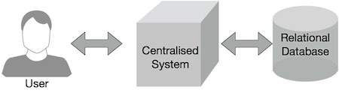

Slide 112
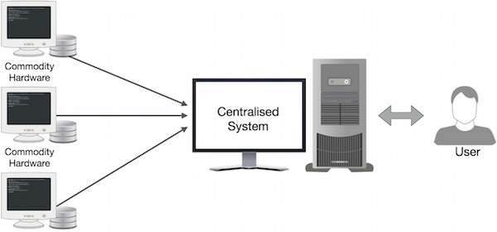

Slide 113
How MapReduce Works
The MapReduce algorithm contains two important tasks, namely Map and Reduce.
The Map task takes a set of data and converts it into another set of data, where individual elements are broken down into tuples (key-value pairs).
The Reduce task takes the output from the Map as an input and combines those data tuples (key-value pairs) into a smaller set of tuples.
The reduce task is always performed after the map job.

Slide 114
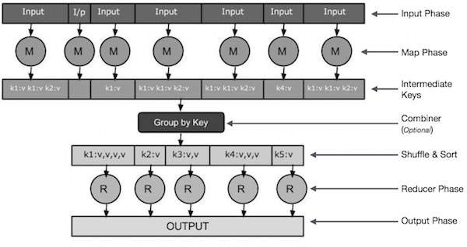

Slide 115
Input Phase − Here we have a Record Reader that translates each record in an input file and sends the parsed data to the mapper in the form of key-value pairs.
Map − Map is a user-defined function, which takes a series of key-value pairs and processes each one of them to generate zero or more key-value pairs.
Intermediate Keys − They key-value pairs generated by the mapper are known as intermediate keys.
Combiner − A combiner is a type of local Reducer that groups similar data from the map phase into identifiable sets. It takes the intermediate keys from the mapper as input and applies a user-defined code to aggregate the values in a small scope of one mapper. It is not a part of the main MapReduce algorithm; it is optional.

Slide 116
Shuffle and Sort − The Reducer task starts with the Shuffle and Sort step. It downloads the grouped key-value pairs onto the local machine, where the Reducer is running. The individual key-value pairs are sorted by key into a larger data list. The data list groups the equivalent keys together so that their values can be iterated easily in the Reducer task.
Reducer − The Reducer takes the grouped key-value paired data as input and runs a Reducer function on each one of them. Here, the data can be aggregated, filtered, and combined in a number of ways, and it requires a wide range of processing. Once the execution is over, it gives zero or more key-value pairs to the final step.
Output Phase − In the output phase, we have an output formatter that translates the final key-value pairs from the Reducer function and writes them onto a file using a record writer.

Slide 117
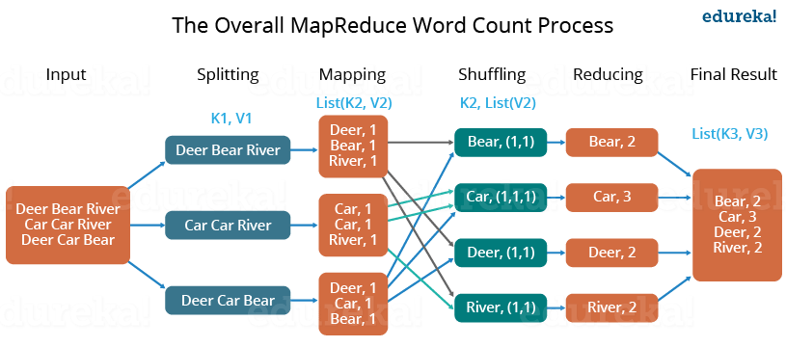

Slide 118
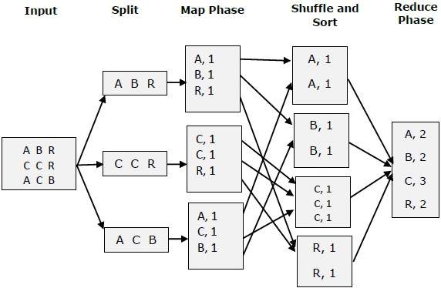

Slide 119
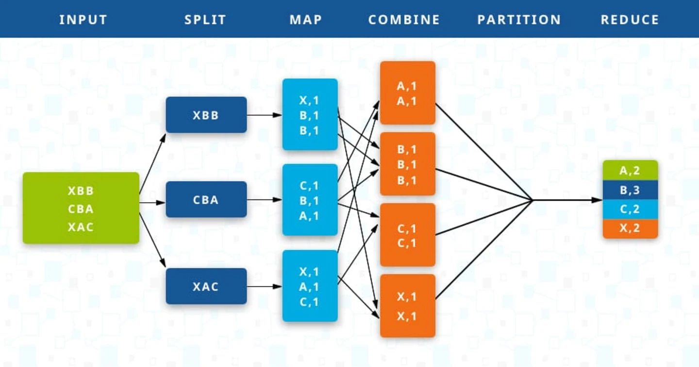

Slide 120
MapReduce-Example
Let us take a real-world example to comprehend the power of MapReduce.
Twitter receives around 500 million tweets per day, which is nearly 3000 tweets per second.
The following illustration shows how Tweeter manages its tweets with the help of MapReduce.

Slide 121
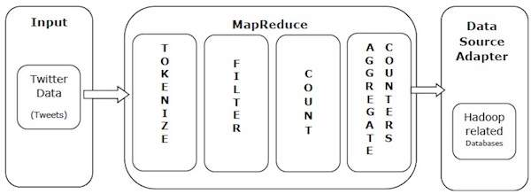

Slide 122
Tokenize − Tokenizes the tweets into maps of tokens and writes them as key-value pairs.
Filter − Filters unwanted words from the maps of tokens and writes the filtered maps as key-value pairs.
Count − Generates a token counter per word.
Aggregate Counters − Prepares an aggregate of similar counter values into small manageable units.

Slide 123
The MapReduce algorithm contains two important tasks, namely Map and Reduce.
The map task is done by means of Mapper Class
The reduce task is done by means of Reducer Class.
Mapper class takes the input, tokenizes it, maps and sorts it. The output of Mapper class is used as input by Reducer class, which in turn searches matching pairs and reduces them.

Slide 124
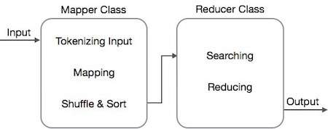

Slide 125
MapReduce implements various mathematical algorithms to divide a task into small parts and assign them to multiple systems. In technical terms, MapReduce algorithm helps in sending the Map & Reduce tasks to appropriate servers in a cluster.
These mathematical algorithms may include the following :-
Sorting
Searching
Indexing
TF-IDF

Slide 126
Sorting
Sorting is one of the basic MapReduce algorithms to process and analyze data. MapReduce implements sorting algorithm to automatically sort the output key-value pairs from the mapper by their keys.
Sorting methods are implemented in the mapper class itself.
In the Shuffle and Sort phase, after tokenizing the values in the mapper class, the Context class (user-defined class) collects the matching valued keys as a collection.
To collect similar key-value pairs (intermediate keys), the Mapper class takes the help of RawComparator class to sort the key-value pairs.
The set of intermediate key-value pairs for a given Reducer is automatically sorted by Hadoop to form key-values (K2, {V2, V2, …}) before they are presented to the Reducer.

Slide 127
Searching
Searching plays an important role in MapReduce algorithm. It helps in the combiner phase (optional) and in the Reducer phase. Let us try to understand how Searching works with the help of an example.
Example
The following example shows how MapReduce employs Searching algorithm to find out the details of the employee who draws the highest salary in a given employee dataset.
Let us assume we have employee data in four different files − A, B, C, and D. Let us also assume there are duplicate employee records in all four files because of importing the employee data from all database tables repeatedly. See the following illustration.

Slide 128
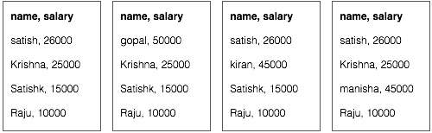

Slide 129
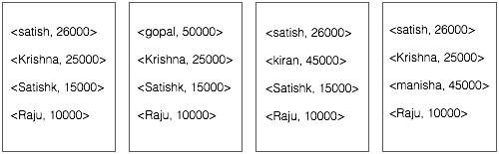
The Map phase processes each input file and provides the employee data in key-value pairs (<k, v> : <emp name, salary>). See the following illustration.

Slide 130
The combiner phase (searching technique) will accept the input from the Map phase as a key-value pair with employee name and salary. Using searching technique, the combiner will check all the employee salary to find the highest salaried employee in each file.
The expected result is as follows −
<satish, 26000>
<gopal, 50000>
<kiran, 45000>
<manisha, 45000>

Slide 131
Reducer phase − Form each file, you will find the highest salaried employee. To avoid redundancy, check all the <k, v> pairs and eliminate duplicate entries, if any. The same algorithm is used in between the four <k, v> pairs, which are coming from four input files. The final output should be as follows −
<gopal, 50000>

Slide 132
Indexing
Normally indexing is used to point to a particular data and its address. It performs batch indexing on the input files for a particular Mapper.
The indexing technique that is normally used in MapReduce is known as inverted index. Search engines like Google and Bing use inverted indexing technique. Let us try to understand how Indexing works with the help of a simple example.

Slide 133
Example
The following text is the input for inverted indexing. Here T[0], T[1], and t[2] are the file names and their content are in double quotes.
T[0] = "it is what it is"
T[1] = "what is it"
T[2] = "it is a banana"
After applying the Indexing algorithm, we get the following output −
"a": {2}
"banana": {2}
"is": {0, 1, 2}
"it": {0, 1, 2}
"what": {0, 1}
Here "a": {2} implies the term "a" appears in the T[2] file. Similarly, "is": {0, 1, 2} implies the term "is" appears in the files T[0], T[1], and T[2].

Slide 134
TF-IDF
TF-IDF is a text processing algorithm which is short for Term Frequency − Inverse Document Frequency. It is one of the common web analysis algorithms. Here, the term 'frequency' refers to the number of times a term appears in a document.
Term Frequency (TF)
It measures how frequently a particular term occurs in a document. It is calculated by the number of times a word appears in a document divided by the total number of words in that document.
TF(the) = (Number of times term the ‘the’ appears in a document) / (Total number of terms in the document)

Slide 135
Inverse Document Frequency (IDF)
It measures the importance of a term. It is calculated by the number of documents in the text database divided by the number of documents where a specific term appears.
While computing TF, all the terms are considered equally important. That means, TF counts the term frequency for normal words like “is”, “a”, “what”, etc. Thus we need to know the frequent terms while scaling up the rare ones, by computing the following −
IDF(the) = log_e(Total number of documents / Number of documents with term ‘the’ in it).

Slide 136
Example
Consider a document containing 1000 words, wherein the word hive appears 50 times. The TF for hive is then (50 / 1000) = 0.05.
Now, assume we have 10 million documents and the word hive appears in 1000 of these. Then, the IDF is calculated as log(10,000,000 / 1,000) = 4.
The TF-IDF weight is the product of these quantities − 0.05 × 4 = 0.20.

Slide 137
Combiner
Combiner always works in between Mapper and Reducer. The output produced by the Mapper is the intermediate output in terms of key-value pairs which is massive in size. If we directly feed this huge output to the Reducer, then that will result in increasing the Network Congestion.
So to minimize this Network congestion we have to put combiner in between Mapper and Reducer. These combiners are also known as semi-reducer.
It is not necessary to add a combiner to your Map-Reduce program, it is optional. Combiner is also a class in our java program like Map and Reduce class that is used in between this Map and Reduce classes.
Combiner helps us to produce abstract details or a summary of very large datasets. When we process or deal with very large datasets using Hadoop Combiner is very much necessary, resulting in the enhancement of overall performance.

Slide 138
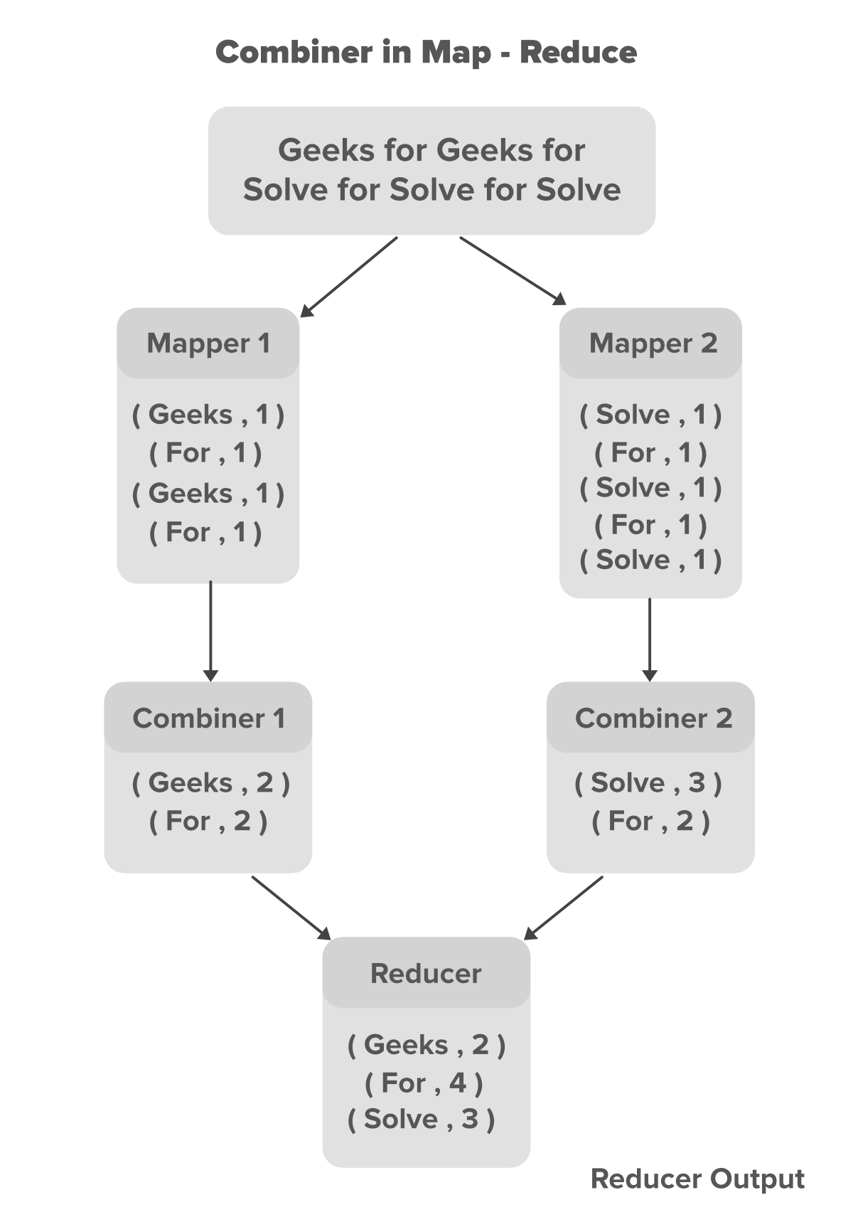
How does combiner work ?

Slide 139
In the above example, we can see that two Mappers are containing different data. the main text file is divided into two different Mappers.
Each mapper is assigned to process a different line of our data. in our above example, we have two lines of data so we have two Mappers to handle each line.
Mappers are producing the intermediate key-value pairs, where the name of the particular word is key and its count is its value. For example for the data Geeks For Geeks For the key-value pairs are shown below.

Slide 140
// Key Value pairs generated for data Geeks For Geeks For
(Geeks,1)
(For,1)
(Geeks,1)
(For,1)

Slide 141
The key-value pairs generated by the Mapper are known as the intermediate key-value pairs or intermediate output of the Mapper. Now we can minimize the number of these key-value pairs by introducing a combiner for each Mapper in our program.
In our case, we have 4 key-value pairs generated by each of the Mapper. since these intermediate key-value pairs are not ready to directly feed to Reducer because that can increase Network congestion so Combiner will combine these intermediate key-value pairs before sending them to Reducer.
The combiner combines these intermediate key-value pairs as per their key. For the above example for data Geeks For Geeks For the combiner will partially reduce them by merging the same pairs according to their key value and generate new key-value pairs as shown below.
// Partially reduced key-value pairs with combiner
(Geeks,2)
(For,2)

Slide 142
With the help of Combiner, the Mapper output got partially reduced in terms of size(key-value pairs) which now can be made available to the Reducer for better performance.
Now the Reducer will again Reduce the output obtained from combiners and produces the final output that is stored on HDFS(Hadoop Distributed File System).

Slide 143
Advantage of combiners
Reduces the time taken for transferring the data from Mapper to Reducer.
Reduces the size of the intermediate output generated by the Mapper.
Improves performance by minimizing Network congestion.
Reduces the workload on the Reducer: Combiners can help reduce the amount of data that needs to be processed by the Reducer. By performing some aggregation or reduction on the data in the Mapper phase itself, combiners can reduce the number of records that are passed on to the Reducer, which can help improve overall performance.
Improves fault tolerance: Combiners can also help improve fault tolerance in MapReduce. In case of a node failure, the MapReduce job can be re-executed from the point of failure. Since combiners perform some of the aggregation or reduction tasks in the Mapper phase itself, this reduces the amount of work that needs to be re-executed, which can help improve fault tolerance.

Slide 144
Improves scalability: By reducing the amount of data that needs to be transferred between the Mapper and Reducer, combiners can help improve the scalability of MapReduce jobs. This is because the amount of network bandwidth required for transferring data is reduced, which can help prevent network congestion and improve overall performance.
Helps optimize MapReduce jobs: Combiners can be used to optimize MapReduce jobs by performing some preliminary data processing before the data is sent to the Reducer. This can help reduce the amount of processing required by the Reducer, which can help improve performance and reduce overall processing time.

Slide 145
Disadvantage of combiners
The intermediate key-value pairs generated by Mappers are stored on Local Disk and combiners will run later on to partially reduce the output which results in expensive Disk Input-Output.
The map-Reduce job can not depend on the function of the combiner because there is no such guarantee in its execution.
Increased resource usage: Combiners can increase the resource usage of MapReduce jobs since they require additional CPU and memory resources to perform their operations. This can be especially problematic in large-scale MapReduce jobs that process huge amounts of data.

Slide 146
Combiners may not always be effective: While combiners can help reduce the amount of data transferred between the Mapper and Reducer, they may not always be effective in doing so. This is because the effectiveness of combiners depends on the data being processed and the operations being performed. In some cases, using combiners may actually increase the amount of data transferred, which can reduce overall performance.
Combiners can introduce data inconsistencies: Since combiners perform partial reductions on the data, they can introduce inconsistencies in the output if they are not implemented correctly. This can be especially problematic if the combiner performs operations that are not associative or commutative, which can lead to incorrect results.
Increased complexity: Combiners can add complexity to MapReduce jobs since they require additional logic to be implemented in the code. This can make the code more difficult to maintain and debug, especially if the combiner logic is complex.

Slide 147
Mapper
Map-Reduce is a programming model that is mainly divided into two phases Map Phase and Reduce Phase. It is designed for processing the data in parallel which is divided on various machines(nodes).
The Hadoop Java programs are consist of Mapper class and Reducer class along with the driver class. Hadoop Mapper is a function or task which is used to process all input records from a file and generate the output which works as input for Reducer.
It produces the output by returning new key-value pairs. The input data has to be converted to key-value pairs as Mapper can not process the raw input records or tuples(key-value pairs).
The mapper also generates some small blocks of data while processing the input records as a key-value pair. we will discuss the various process that occurs in Mapper, There key features and how the key-value pairs are generated in the Mapper.

Slide 148
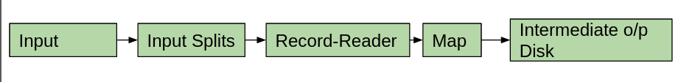

Slide 149
The Mapper mainly consists of 5 components: Input, Input Splits, Record Reader, Map, and Intermediate output disk. The Map Task is completed with the contribution of all this available component.
Input: Input is records or the datasets that are used for analysis purposes. This Input data is set out with the help of InputFormat. It helps in identifying the location of the Input data which is stored in HDFS(Hadoop Distributed File System).

Slide 150
2. Input-Splits: These are responsible for converting the physical input data to some logical form so that Hadoop Mapper can easily handle it. Input-Splits are generated with the help of InputFormat.
A large data set is divided into many input-splits which depend on the size of the input dataset. There will be a separate Mapper assigned for each input-splits. Input-Splits are only referencing to the input data, these are not the actual data.
DataBlocks are not the only factor that decides the number of input-splits in a Map-Reduce. we can manually configure the size of input-splits in mapred.max.split.size property while the job is executing. All of these input-splits are utilized by each of the data blocks.
The size of input splits is measured in bytes. Each input-split is stored at some memory location (Hostname Strings). Map-Reduce places map tasks near the location of the split as close as it is possible. The input-split with the larger size executed first so that the job-runtime can be minimized.

Slide 151
3.Record-Reader: Record-Reader is the process which deals with the output obtained from the input-splits and generates it’s own output as key-value pairs until the file ends. Each line present in a file will be assigned with the Byte-Offset with the help of Record-Reader. By-default Record-Reader uses TextInputFormat for converting the data obtained from the input-splits to the key-value pairs because Mapper can only handle key-value pairs.
4.Map: The key-value pair obtained from Record-Reader is then feed to the Map which generates a set of pairs of intermediate key-value pairs.

Slide 152
5.Intermediate output disk: Finally, the intermediate key-value pair output will be stored on the local disk as intermediate output.
How to calculate the number of Mappers In Hadoop:-
The number of blocks of input file defines the number of map-task in the Hadoop Map-phase, which can be calculated with the help of the below formula.
Mapper = (total data size)/ (input split size)
For Example: For a file of size 10TB(Data Size) where the size of each data block is 128 MB(input split size) the number of Mappers will be around 81920.

Slide 153
Partitioner
A partitioner works like a condition in processing an input dataset. The partition phase takes place after the Map phase and before the Reduce phase.
The number of partitioners is equal to the number of reducers. That means a partitioner will divide the data according to the number of reducers. Therefore, the data passed from a single partitioner is processed by a single Reducer.

Slide 154
A partitioner partitions the key-value pairs of intermediate Map-outputs. It partitions the data using a user-defined condition, which works like a hash function. The total number of partitions is same as the number of Reducer tasks for the job. Let us take an example to understand how the partitioner works.

Slide 155
Id | Name | Age | Gender | Salary
1201 | gopal | 45 | Male | 50,000
1202 | manisha | 40 | Female | 50,000
1203 | khalil | 34 | Male | 30,000
1204 | prasanth | 30 | Male | 30,000
1205 | kiran | 20 | Male | 40,000
1206 | laxmi | 25 | Female | 35,000
1207 | bhavya | 20 | Female | 15,000
1208 | reshma | 19 | Female | 15,000
1209 | kranthi | 22 | Male | 22,000
1210 | Satish | 24 | Male | 25,000
1211 | Krishna | 25 | Male | 25,000
1212 | Arshad | 28 | Male | 20,000
1213 | lavanya | 18 | Female | 8,000

Slide 156
We have to write an application to process the input dataset to find the highest salaried employee by gender in different age groups (for example, below 20, between 21 to 30, above 30)

Slide 157
Reducer
Map-Reduce is a programming model that is mainly divided into two phases i.e. Map Phase and Reduce Phase. It is designed for processing the data in parallel which is divided on various machines(nodes).
The Hadoop Java programs are consist of Mapper class and Reducer class along with the driver class. Reducer is the second part of the Map-Reduce programming model.
The Mapper produces the output in the form of key-value pairs which works as input for the Reducer.

Slide 158
But before sending this intermediate key-value pairs directly to the Reducer some process will be done which shuffle and sort the key-value pairs according to its key values, which means the value of the key is the main decisive factor for sorting.
The output generated by the Reducer will be the final output which is then stored on HDFS(Hadoop Distributed File System). Reducer mainly performs some computation operation like addition, filtration, and aggregation.
By default, the number of reducers utilized for process the output of the Mapper is 1 which is configurable and can be changed by the user according to the requirement.

Slide 159
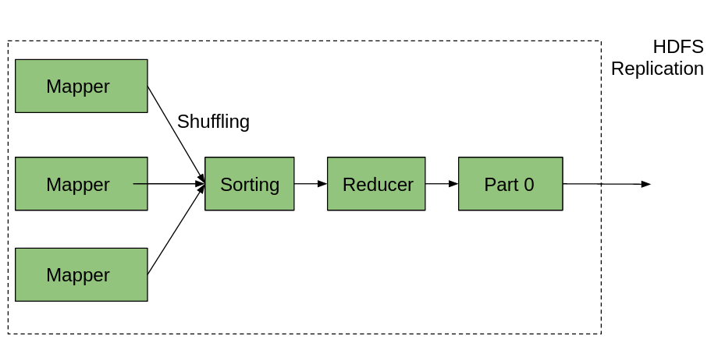
Let’s understand the Reducer in Map-Reduce:

Slide 160
Here, in the above image, we can observe that there are multiple Mapper which are generating the key-value pairs as output. The output of each mapper is sent to the sorter which will sort the key-value pairs according to its key value. Shuffling also takes place during the sorting process and the output will be sent to the Reducer part and final output is produced.
Let’s take an example to understand the working of Reducer. Suppose we have the data of a college faculty of all departments stored in a CSV file. In case we want to find the sum of salaries of faculty according to their department then we can make their dept. title as key and salaries as value. The Reducer will perform the summation operation on this dataset and produce the desired output.

Slide 161
The Reducer Of Map-Reduce is consist of mainly 3 processes/phases:
Shuffle: Shuffling helps to carry data from the Mapper to the required Reducer. With the help of HTTP, the framework calls for applicable partition of the output in all Mappers.
Sort: In this phase, the output of the mapper that is actually the key-value pairs will be sorted on the basis of its key value.
Reduce: Once shuffling and sorting will be done the Reducer combines the obtained result and perform the computation operation as per the requirement. OutputCollector.collect() property is used for writing the output to the HDFS. Keep remembering that the output of the Reducer will not be sorted.

Slide 162
Module-4
Hadoop Framework

Slide 163
Hadoop - Introduction
Hadoop is an open source framework from Apache and is used to store process and analyze data which are very huge in volume.
Hadoop is written in Java and is not OLAP (online analytical processing). It is used for batch/offline processing.It is being used by Facebook, Yahoo, Google, Twitter, LinkedIn and many more.
Hadoop is an Apache open source framework written in java that allows distributed processing of large datasets across clusters of computers using simple programming models.
The Hadoop framework application works in an environment that provides distributed storage and computation across clusters of computers. Hadoop is designed to scale up from single server to thousands of machines, each offering local computation and storage.

Slide 164
Why Hadoop?
It's quick to get Hadoop contagious. Its adoption in one organization may contribute to the adoption of similar practices in other organizations.
Handling massive data seems to be much simpler today, thanks to this piece of technology's robustness and cost-effectiveness. Another great function is the ability to incorporate HIVE into an EMR workflow.
It's extremely easy to start a cluster, install HIVE, and begin running basic SQL analytics in no time. Let's take a closer look at why Hadoop is so strong.

Slide 165
1. Flexible
Since only 20% of data in enterprises is organized and the remaining is unstructured, managing unstructured data that goes unattended is critical.
Hadoop is a software platform that handles various kinds of Big Data, whether structured or unstructured, encoded or formatted, or some other kind of data, and makes it usable for decision-making.
Hadoop is also easy, appropriate, and schema-free! Though Hadoop is better known for supporting Java programming, the MapReduce technique allows any programming language to be used in Hadoop. Hadoop is better suited for Windows and Linux, but it can also run on BSD and OS X.

Slide 166
2. Scalable
Hadoop is a flexible framework in the sense that new nodes can be introduced to the system as required without having to change data formats, data loading practices, program writing methods, or even current applications.
Hadoop is free and open-source software that runs on commodity hardware. Hadoop is also fault resistant, which ensures that if a node fails or goes out of operation, the machine will simply reallocate work to another place in the data and resume processing as if nothing has happened!

Slide 167
3. Building a more efficient data economy:
Hadoop has revolutionized big data mining and analysis all over the world. Until now, businesses have been concerned with how to handle the constant inflow of data into their applications. Hadoop is more akin to a "dam," collecting an infinite number of data and generating a great deal of power in the form of related data. Hadoop has fully altered the economics of data storage and analysis!
4. Robust Ecosystem:
Hadoop provides a rather versatile and rich environment that is well-tailored to developers, web start-ups, and other organizations’ computational needs. The Ecosystem is made up of several similar initiatives, including MapReduce, Hive, HBase, Zookeeper, HCatalog, and Apache Pig, which make it capable of delivering a wide range of services.

Slide 168
5. Hadoop is getting more “Real-Time”!
Have you ever wondered how to feed data into a cluster and test it in real-time? It's a problem for which Hadoop has a solution. Yes, skills are becoming more real-time. It also offers a standardized approach to a diverse range of big data analytics APIs, such as MapReduce, query languages, and database access, among others.
6. Cost-Effective:
With so many wonderful features, the icing on the cake is that Hadoop saves money by adding massively parallel processing to commodity servers, resulting in a significant decrease in the cost per terabyte of storage, making it possible to model all of your files. The basic concept here is to do cost-effective data analysis through the internet!

Slide 169
History of Hadoop
The Hadoop was started by Doug Cutting and Mike Cafarella in 2002. Its origin was the Google File System paper, published by Google.
In 2002, Doug Cutting and Mike Cafarella started to work on a project, Apache Nutch. It is an open source web crawler software project.
While working on Apache Nutch, they were dealing with big data. To store that data they have to spend a lot of costs which becomes the consequence of that project. This problem becomes one of the important reason for the emergence of Hadoop.
In 2003, Google introduced a file system known as GFS (Google file system). It is a proprietary distributed file system developed to provide efficient access to data.
In 2004, Google released a white paper on Map Reduce. This technique simplifies the data processing on large clusters.

Slide 170
In 2005, Doug Cutting and Mike Cafarella introduced a new file system known as NDFS (Nutch Distributed File System). This file system also includes Map reduce.
In 2006, Doug Cutting quit Google and joined Yahoo. On the basis of the Nutch project, Dough Cutting introduces a new project Hadoop with a file system known as HDFS (Hadoop Distributed File System). Hadoop first version 0.1.0 released in this year.
Doug Cutting gave named his project Hadoop after his son's toy elephant.

Slide 171
In 2007, Yahoo runs two clusters of 1000 machines.
In 2008, Hadoop became the fastest system to sort 1 terabyte of data on a 900 node cluster within 209 seconds.
In 2013, Hadoop 2.2 was released.
In 2017, Hadoop 3.0 was released.

Slide 172
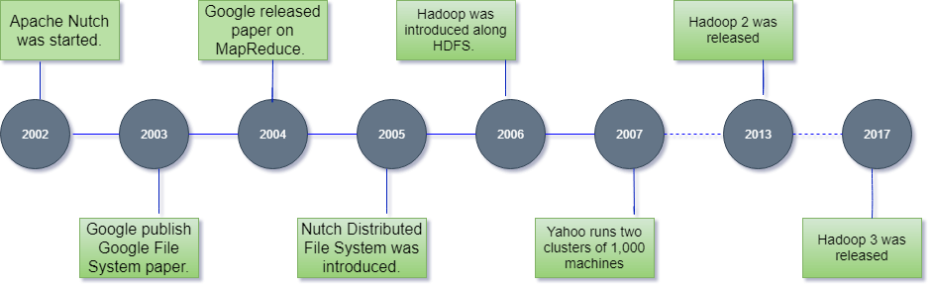

Slide 173
Components of Hadoop
Hadoop is a Big Data storage and management system that makes use of distributed storage and parallel processing. It is the most widely used program for dealing with large amounts of data. Hadoop is made up of four components:-
Hadoop Common
Hadoop HDFS - Hadoop's storage unit is the Hadoop Distributed File System (HDFS).
Hadoop MapReduce - Hadoop MapReduce is the Hadoop processing unit.
Hadoop YARN - Hadoop YARN is a Hadoop resource management unit.

Slide 174
Hadoop common or Common Utilities
Hadoop common or Common utilities are nothing but our java library and java files or we can say the java scripts that we need for all the other components present in a Hadoop cluster.
these utilities are used by HDFS, YARN, and MapReduce for running the cluster. Hadoop Common verify that Hardware failure in a Hadoop cluster is common so it needs to be solved automatically in software by Hadoop Framework.

Slide 175
Hadoop HDFS
HDFS is Hadoop's default data storage, and data is saved there before it's required for processing. The data in HDFS is divided into several units called blocks and distributed throughout the cluster.
It generates several replicas of data blocks and distributes them through clusters for consistent and convenient access.
Namenode, Data Node, and Secondary Name Node are the other three key components of HDFS. It employs a Master-Slave architecture paradigm.
In this architecture, the Namenode serves as a master node to control the storage system, while the Data node serves as a slave node to manage the Hadoop cluster's various structures.

Slide 176
HDFS is a file system designed specifically for storing large datasets on commodity hardware. For the full processor, an enterprise version of a server costs about $10,000 per terabyte.
If you need to purchase 100 of these enterprise-level servers, the cost would exceed a million dollars. Data nodes in Hadoop can be commodity devices.
You won't have to spend millions on data nodes this way. The word node, on the other hand, has always been an enterprise server.

Slide 177
File Block In HDFS
Data in HDFS is always stored in terms of blocks. So the single block of data is divided into multiple blocks of size 128MB which is default and you can also change it manually.
Let’s understand this concept of breaking down of file in blocks with an example. Suppose you have uploaded a file of 400MB to your HDFS then what happens is this file got divided into blocks of 128MB+128MB+128MB+16MB = 400MB size. Means 4 blocks are created each of 128MB except the last one.

Slide 178
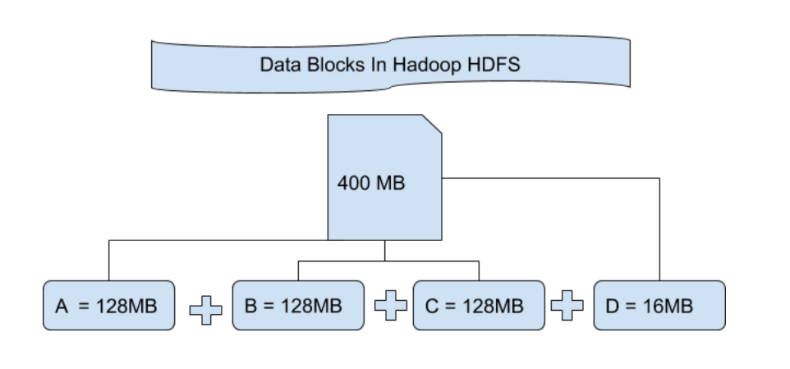

Slide 179
Replication
In HDFS Replication ensures the availability of the data. Replication is making a copy of something and the number of times you make a copy of that particular thing can be expressed as it’s Replication Factor. As we have seen in File blocks that the HDFS stores the data in the form of various blocks at the same time Hadoop is also configured to make a copy of those file blocks.
By default, the Replication Factor for Hadoop is set to 3 which can be configured means you can change it manually as per your requirement like in above example we have made 4 file blocks which means that 3 Replica or copy of each file block is made means total of 4×3 = 12 blocks are made for the backup purpose.

Slide 180
Rack Awareness
The rack is nothing but just the physical collection of nodes in our Hadoop cluster (maybe 30 to 40). A large Hadoop cluster is consists of so many Racks . with the help of this Racks information Namenode chooses the closest Datanode to achieve the maximum performance while performing the read/write information which reduces the Network Traffic.

Slide 181
Features of HDFS
Distributed storage is provided.
It is possible to implement it on product hardware.
Provides data protection.
Highly fault-tolerant - if one system breaks down, the data from that machine is transferred to the next

Slide 182
Master and Slave Nodes
HDFS is composed of master and slave nodes. The master is the name node, while the slaves are the data nodes.
The name node is in charge of the data nodes' operations. It also keeps track of metadata.
The data nodes are responsible for reading, writing, processing, and replicating information.
They often relay signals to the name node known as heartbeats. The data node's status is indicated by these heartbeats.

Slide 183
NameNode
NameNode works as a Master in a Hadoop cluster that guides the Datanode(Slaves). Namenode is mainly used for storing the Metadata i.e. the data about the data. Meta Data can be the transaction logs that keep track of the user’s activity in a Hadoop cluster.
Meta Data can also be the name of the file, size, and the information about the location(Block number, Block ids) of Datanode that Namenode stores to find the closest DataNode for Faster Communication. Namenode instructs the DataNodes with the operation like delete, create, Replicate, etc.

Slide 184
DataNode
DataNodes works as a Slave DataNodes are mainly utilized for storing the data in a Hadoop cluster, the number of DataNodes can be from 1 to 500 or even more than that. The more number of DataNode, the Hadoop cluster will be able to store more data. So it is advised that the DataNode should have High storing capacity to store a large number of file blocks.

Slide 185
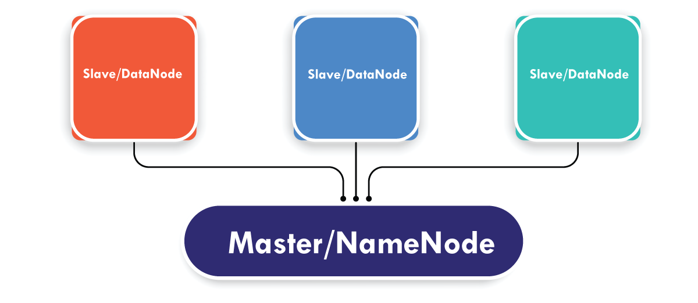

Slide 186
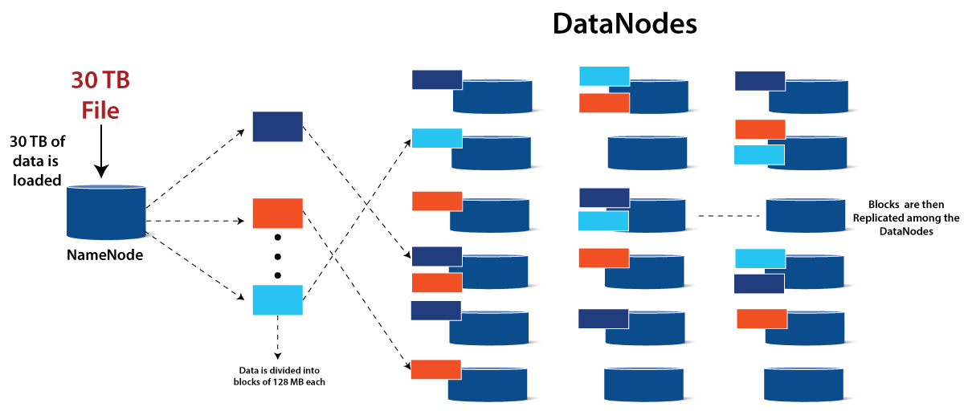

Slide 187
Consider the fact that the name node contains 30TB of data.
This data is replicated among the data notes by the name node, which delivers it across the data nodes.
The blue, grey and red data are replicated among the three data nodes, as seen in the image above.
By default, data replication takes place three times. This is achieved so that if a commodity machine breaks down, a new machine with the same data can be used to replace it.

Slide 188
Hadoop MapReduce
Hadoop MapReduce is the Hadoop processing unit. The processing takes place on the slave nodes, and the final output is sent to the master node in the MapReduce approach.
To handle all of the data, a data containing code is used. Concerning the raw data, this coded data is normally very small. To run a heavy-duty operation on computers, you only need to submit a few kilobytes of code.
Apache Hadoop includes MapReduce as a key feature. It allows programmers to handle massive amounts of data while writing programs.
MapReduce is a Java program that can process vast volumes of data. Its main function is to divide the data into small, separate bits that can be processed in parallel.

Slide 189
The MapReduce algorithm is made up of two main parts: Map and Reduce. When the Map function completes its mission, the Reduce function begins.
The map takes a set of data and converts it into tuples. The Reduce function takes the Map function's output and combines it with another set of tuples to generate a new set of tuples.
Hadoop relies heavily on MapReduce's parallel processing functionality. It enables big data processing to be performed on several computers in the same cluster.

Slide 190
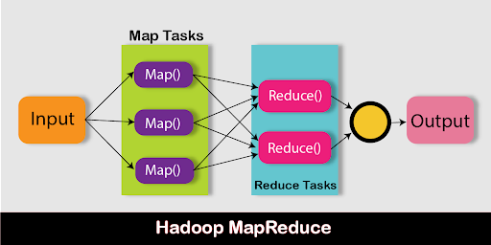

Slide 191
Map Stage:
The input data is converted using the mapper tool. The data can be stored in HDFS in a variety of formats, such as folders or directories. The entire data set is sequentially transferred through the Map Function, which transforms it into tuples.
Reduce stage:
The data is shuffled and reduced to some extent at this point. It uses the Map function's output to perform the data processing function. It generates a new output after the reduced operation is completed, which is automatically stored in the Hadoop Distributed File System.

Slide 192
Hadoop YARN
The YARN's key concept is to separate the resource control and work scheduling functions into various daemons. YARN is responsible for allocating resources to the Hadoop cluster's various applications.
Resource manager and Node manager are the two key components of YARN. The data computation system is made up of these two components.
The resource manager is in charge of delegating work to all applications in the system, while the node manager is in charge of containers and tracks their resource usage (CPU, disk, memory, and network) and sends the same information to the Resource manager.
Hadoop's YARN acronym stands for Yet Another Resource Negotiator. It is Hadoop's resource management unit, and it is used in Hadoop version 2 as a component.

Slide 193
Hadoop YARN serves as an operating system for Hadoop. It's a file system that uses HDFS as a foundation.
It's in charge of handling cluster resources to prevent overloading a single server.
It manages work schedules to ensure that jobs are planned in the right places.

Slide 194
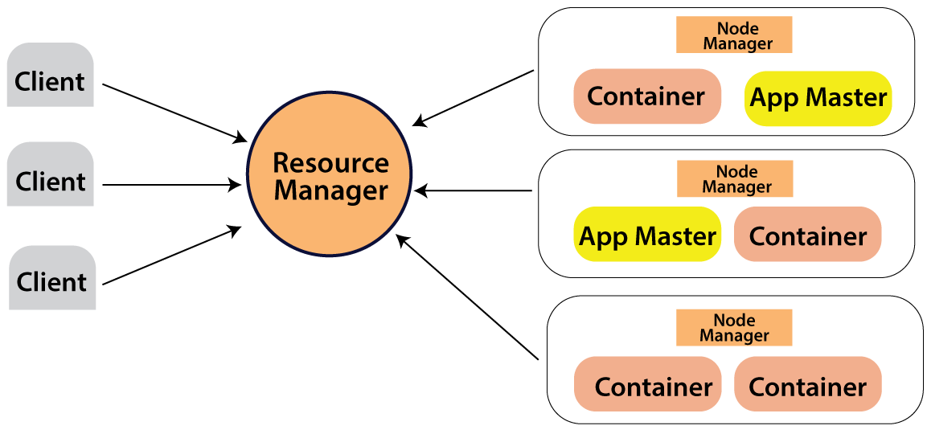

Slide 195
Assume a client computer requires the execution of a query or the retrieval of code for data processing. The resource manager (Hadoop Yarn), who is responsible for the resource allocation and management, receives this job request.
Each node has its node manager in the node section. These node managers are responsible for the nodes and keep track of their resource usage.
Physical resources such as RAM, CPU, and hard drives are contained within the containers. The app master requests the container from the node manager whenever a job request is received. The resource is returned to the Resource Manager until the node manager has received it.

Slide 196
YARN components
Hadoop YARN distributes work among its components and keeps them accountable for completing the task at hand. The tasks assigned to the various Core components of YARN are described below.
A global Resource manager is in charge of accepting user work submissions and scheduling them by allocating resources.
To the Resource manager, a Node manager is a Reporter. Each Node has a node manager who reports back to the Resource Manager on the functionality of each node.
Each framework has its Application Master, which aids the Node Manager in executing and monitoring tasks and smoothing out the resource allocation process.
The Resource container, which is operated by Node managers and distributed with the system resources allocated to individual applications, is another aspect of YARN.

Slide 197
Features of Hadoop Which Makes It Popular
Open Source:
Hadoop is open-source, which means it is free to use. Since it is an open-source project the source-code is available online for anyone to understand it or make some modifications as per their industry requirement.

Slide 198
2. Highly Scalable Cluster:
Hadoop is a highly scalable model. A large amount of data is divided into multiple inexpensive machines in a cluster which is processed parallelly.
the number of these machines or nodes can be increased or decreased as per the enterprise’s requirements.
In traditional RDBMS(Relational DataBase Management System) the systems can not be scaled to approach large amounts of data.

Slide 199
3. Fault Tolerance is Available:
Hadoop uses commodity hardware(inexpensive systems) which can be crashed at any moment.
In Hadoop data is replicated on various DataNodes in a Hadoop cluster which ensures the availability of data if somehow any of your systems got crashed.
You can read all of the data from a single machine if this machine faces a technical issue data can also be read from other nodes in a Hadoop cluster because the data is copied or replicated by default. By default, Hadoop makes 3 copies of each file block and stored it into different nodes.
This replication factor is configurable and can be changed by changing the replication property in the hdfs-site.xml file.

Slide 200
4. High Availability is Provided:
Fault tolerance provides High Availability in the Hadoop cluster. High Availability means the availability of data on the Hadoop cluster.
Due to fault tolerance in case if any of the DataNode goes down the same data can be retrieved from any other node where the data is replicated. The High available Hadoop cluster also has 2 or more than two Name Node i.e. Active NameNode and Passive NameNode also known as stand by NameNode.
In case if Active NameNode fails then the Passive node will take the responsibility of Active Node and provide the same data as that of Active NameNode which can easily be utilized by the user.

Slide 201
5. Cost-Effective:
Hadoop is open-source and uses cost-effective commodity hardware which provides a cost-efficient model, unlike traditional Relational databases that require expensive hardware and high-end processors to deal with Big Data.
The problem with traditional Relational databases is that storing the Massive volume of data is not cost-effective, so the company’s started to remove the Raw data. which may not result in the correct scenario of their business.
Means Hadoop provides us 2 main benefits with the cost one is it’s open-source means free to use and the other is that it uses commodity hardware which is also inexpensive.

Slide 202
6. Hadoop Provide Flexibility:
Hadoop is designed in such a way that it can deal with any kind of dataset like structured(MySql Data), Semi-Structured(XML, JSON), Un-structured (Images and Videos) very efficiently.
This means it can easily process any kind of data independent of its structure which makes it highly flexible.
It is very much useful for enterprises as they can process large datasets easily, so the businesses can use Hadoop to analyze valuable insights of data from sources like social media, email, etc. With this flexibility, Hadoop can be used with log processing, Data Warehousing, Fraud detection, etc.

Slide 203
7. Easy to Use:
Hadoop is easy to use since the developers need not worry about any of the processing work since it is managed by the Hadoop itself. Hadoop ecosystem is also very large comes up with lots of tools like Hive, Pig, Spark, HBase, Mahout, etc.
8. Hadoop uses Data Locality:
The concept of Data Locality is used to make Hadoop processing fast. In the data locality concept, the computation logic is moved near data rather than moving the data to the computation logic. The cost of Moving data on HDFS is costliest and with the help of the data locality concept, the bandwidth utilization in the system is minimized.

Slide 204
9. Provides Faster Data Processing:
Hadoop uses a distributed file system to manage its storage i.e. HDFS(Hadoop Distributed File System).
In DFS(Distributed File System) a large size file is broken into small size file blocks then distributed among the Nodes available in a Hadoop cluster, as this massive number of file blocks are processed parallelly which makes Hadoop faster, because of which it provides a High-level performance as compared to the traditional DataBase Management Systems.

Slide 205
10. Support for Multiple Data Formats: Hadoop supports multiple data formats like CSV, JSON, Avro, and more, making it easier to work with different types of data sources. This makes it more convenient for developers and data analysts to handle large volumes of data with different formats.
11. High Processing Speed: Hadoop’s distributed processing model allows it to process large amounts of data at high speeds. This is achieved by distributing data across multiple nodes and processing it in parallel. As a result, Hadoop can process data much faster than traditional database systems.

Slide 206
12. Integration with Other Tools: Hadoop integrates with other popular tools like Apache Spark, Apache Flink, and Apache Storm, making it easier to build data processing pipelines. This integration allows developers and data analysts to use their favorite tools and frameworks for building data pipelines and processing large datasets.
13. Secure: Hadoop provides built-in security features like authentication, authorization, and encryption. These features help to protect data and ensure that only authorized users have access to it. This makes Hadoop a more secure platform for processing sensitive data.

Slide 207
Differences between RDBMS and Hadoop
S.No. | RDBMS | Hadoop
1. | Traditional row-column based databases, basically used for data storage, manipulation and retrieval. | An open-source software used for storing data and running applications or processes concurrently.
2. | In this structured data is mostly processed. | In this both structured and unstructured data is processed.
3. | It is best suited for OLTP environment. | It is best suited for BIG data.
4. | It is less scalable than Hadoop. | It is highly scalable.
5. | Data normalization is required in RDBMS. | Data normalization is not required in Hadoop.
6. | It stores transformed and aggregated data. | It stores huge volume of data.
7. | It has no latency in response. | It has some latency in response.
8. | The data schema of RDBMS is static type. | The data schema of Hadoop is dynamic type.
9. | High data integrity available. | Low data integrity available than RDBMS.
10. | Cost is applicable for licensed software. | Free of cost, as it is an open source software.

Slide 208
Distributed computing System
A distributed system is a collection of independent computers or digital devices that communicate and coordinate their actions by passing messages over a network.
These computers work together as a single system to achieve a common goal, such as processing large amounts of data, providing a web service, or managing a complex application.
In a distributed system, each computer, also called a node, performs a specific task or set of tasks and communicates with other nodes to share information for the coordination of actions.
One of the advantages of these nodes is that they can be located in different geographic locations with different hardware configurations and operating systems. This provides flexibility in the usage of the system.

Slide 209
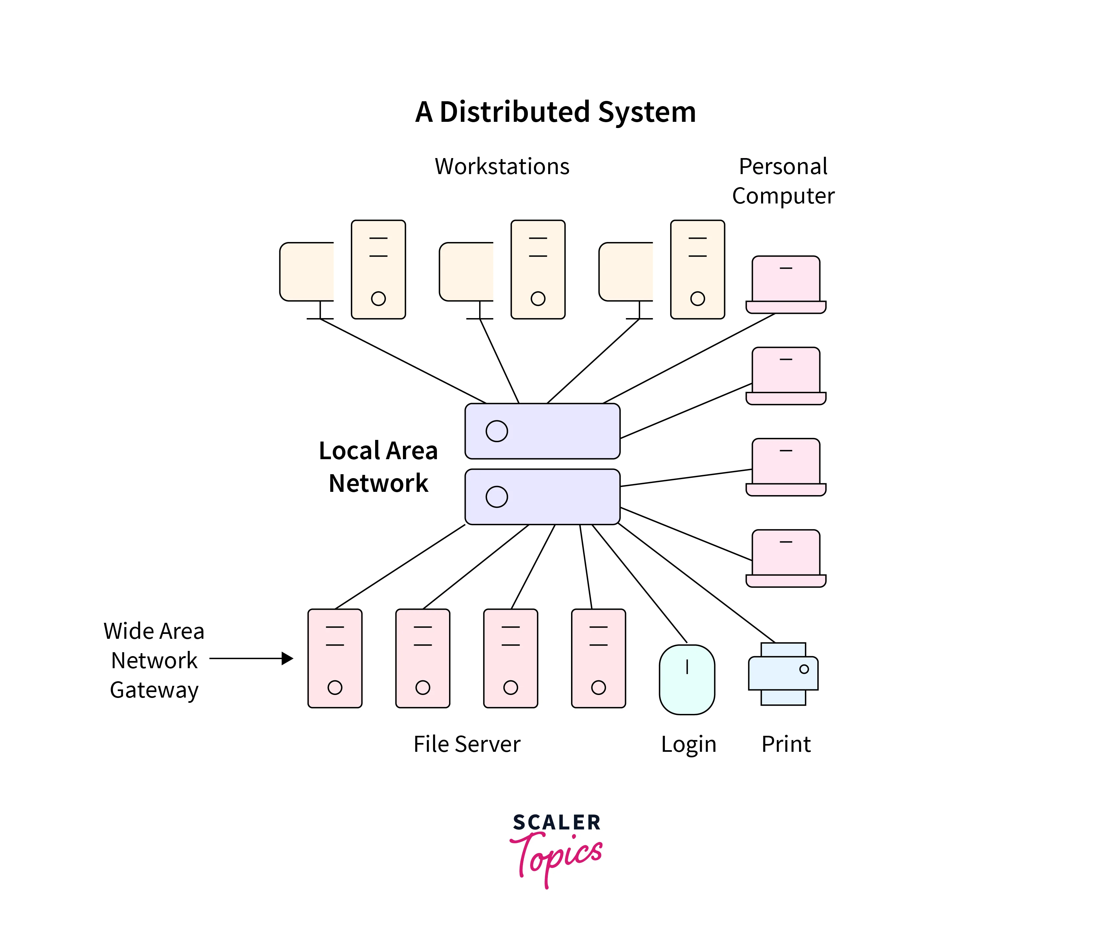

Slide 210
Distributed Systems: Challenges/Failures
Heterogeneity
Heterogeneity is one of the challenges of a distributed system that refers to differences in hardware, software, or network configurations among nodes.
This can present challenges for communication and coordination. Techniques for managing heterogeneity include middleware, virtualization, standardization, and service-oriented architecture. These approaches can help build robust and scalable systems that accommodate diverse configurations.

Slide 211
Scalability
Scalability is one of the challenges in distributed systems. As distributed systems grow in size and complexity, it becomes increasingly difficult to maintain their performance and availability. The major challenges are security, maintaining consistency of data in every system, network latency between systems, resource allocation, or proper node balancing across multiple nodes.
Openness
Openness in distributed systems refers to achieving a standard between different systems that use different standards, protocols, and data formats. It is crucial to ensure that different systems can communicate and exchange data seamlessly without the need for extensive manual intervention. It is also important to maintain the correct amount of transparency and security in such systems.

Slide 212
Transparency
Transparency refers to the level of abstraction present in the system to hide complex information from the user. It is essential to ensure that failures are transparent to users and do not affect the overall system's performance. Systems with different hardware and software configurations provide to be a challenge for Transparency. Security is also a concern to maintain transparency in distributed systems.
Concurrency
Concurrency is the ability to process data parallelly on different nodes of the system. One of the primary challenges of concurrency in distributed systems is the issue of race conditions. Problems like communication and synchronization between nodes also pose a challenge. When a node fails, the fault tolerance mechanism must ensure synchronization.

Slide 213
Security
The distributed and heterogeneous nature of the distributed system makes security a major challenge for data processing systems. The system must ensure confidentiality from unauthorized access as data is transmitted across multiple nodes.
Various methods like Digital signatures, Checksums, and Hash functions should be used to verify the integrity of data as data is being modified by multiple systems. Authentication mechanisms are also challenging as users and processes may be located on different node

Slide 214
Failure Handling
One of the primary challenges of failure handling in distributed systems is identifying and diagnosing failures as failure can occur at any node.
Logging mechanisms should be implemented to identify the failed nodes. Techniques like redundancy, replication, and checkpoints should be used to ensure the continuous working of the system in case of a node failure.
Data recovery should be implemented with techniques like Rollback to recover data in the event of a failure.

Slide 215
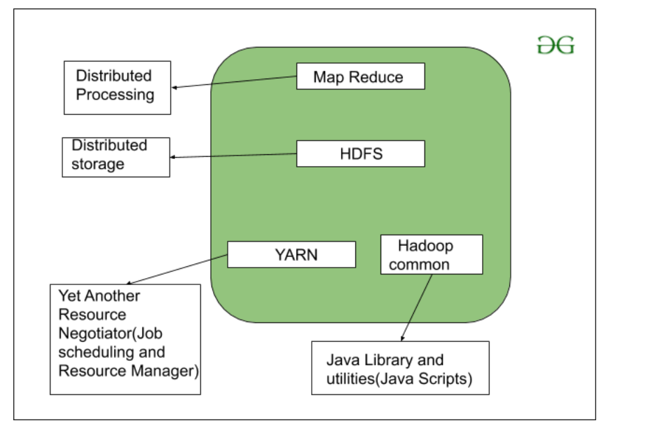
Conceptual layer of Hadoop

Slide 216
Module-5
PIG and HIV

Slide 217
PIG
To analyze and process big data, Hadoop uses Map Reduce. Map Reduce is a program that is written in Java.
But, developers find it challenging to write and maintain these lengthy Java codes. With Apache Pig, developers can quickly analyze and process large data sets without using complex Java codes.
Apache Pig developed by Yahoo researchers executes Map Reduce jobs on extensive datasets and provides an easy interface for developers to process the data efficiently.

Slide 218
PIG
Map Reduce requires programs to be translated into map and reduce stages.
Since not all data analysts were familiar with Map Reduce, hence, Apache pig was introduced by Yahoo researchers to bridge the gap.
The Pig was built on top of Hadoop that provides a high level of abstraction and enables programmers to spend less time writing complex Map Reduce programs.
Pig is not an acronym; it was named after a domestic animal. As an animal pig eats anything, Pig can work upon any kind of data.

Slide 219
Apache Pig Architecture in Hadoop
Apache Pig architecture consists of a Pig Latin interpreter that uses Pig Latin scripts to process and analyze massive datasets. Programmers use Pig Latin language to analyze large datasets in the Hadoop environment. Apache pig has a rich set of datasets for performing different data operations like join, filter, sort, load, group, etc.
Programmers must use Pig Latin language to write a Pig script to perform a specific task. Pig converts these Pig scripts into a series of Map-Reduce jobs to ease programmers’ work. Pig Latin programs are executed via various mechanisms such as UDFs, embedded, and Grunt shells

Slide 220
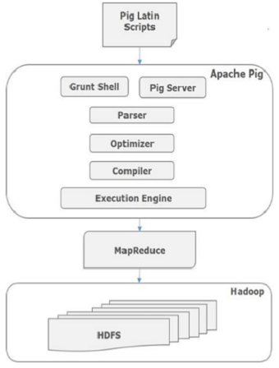

Slide 221
Apache Pig Components
Parser
Initially the Pig Scripts are handled by the Parser. It checks the syntax of the script, does type checking, and other miscellaneous checks. The output of the parser will be a DAG (directed acyclic graph), which represents the Pig Latin statements and logical operators.
In the DAG, the logical operators of the script are represented as the nodes and the data flows are represented as edges.

Slide 222
Optimizer
Once parsing operation is completed and a DAG output is generated, the output is passed to the optimizer
The optimizer then performs the optimization activities on the output, such as split, merge, projection, pushdown, transform, and reorder, etc.
The optimizer processes the extracted data and omits unnecessary data or columns by performing pushdown and projection activity and improves query performance.

Slide 223
Compiler
The compiler compiles the output that is generated by the optimizer into a series of Map Reduce jobs. The compiler automatically converts Pig jobs into Map Reduce jobs and optimizes performance by rearranging the execution order.

Slide 224
Execution Engine
After performing all the above operations, these Map Reduce jobs are submitted to the execution engine, which is then executed on the Hadoop platform to produce the desired results.
You can then use the DUMP statement to display the results on screen or STORE statements to store the results in HDFS (Hadoop Distributed File System).

Slide 225
Execution Mode
Apache Pig is executed in two execution modes that are local and Map Reduce. The choice of execution mode depends on where the data is stored and where you want to run the Pig script. You can either store your data locally (in a single machine) or in a distributed Hadoop cluster environment.
Local Mode – You can use local mode if your dataset is small. In local mode, Pig runs in a single JVM using the local host and file system. In this mode, parallel mapper execution is impossible as all files are installed and run on the localhost. You can use pig -x local command to specify the local mode.
Map Reduce Mode – Apache Pig uses the Map Reduce mode by default. In Map Reduce mode, a programmer executes the Pig Latin statements on data that is already stored in the HDFS (Hadoop Distributed File System). You can use pig -x mapreduce command to specify the Map-Reduce mode.

Slide 226
Pig Latin Data Model
Pig Latin data model allows Pig to handle any kind of data. Pig Latin data model is fully nested and can treat both atomic like integer, float, and non-atomic complex data types such as Map and tuple.
Let us understand the data model in depth:
Atom – An atom is a single value stored in a string form and can be used as a number and string. Atomic values of Pig are integer, double, float, byte array, and char array. A single atomic value is also called a field.
For example, “Kiara” or 27

Slide 227
Tuple – A tuple is a record that contains an ordered set of fields (any type). A tuple is very similar to a row in an RDBMS (Relational Database Management System).
For example, (Kiara, 27)
Bag – An atom is a single value stored in a string form and can be used as a number and string. Atomic values of Pig are integer, double, float, byte array, and char array. A single atomic value is also called a field.
For example, {(Kiara, 27), (Kehsav, 45)}
Map – A key-value pair set is known as a map. The key must be unique and should be of a char array type. However, the value can be of any kind.
For example, [name#Kiara, age#27]
Relation – A bag of tuples is called a relation.

Slide 228
Execution Flow of a Pig Job
The following steps explain the execution flow of a Pig job:
The developer writes a Pig script using the Pig Latin language and stores it in the local file system.
After submitting the Pig scripts, Apache Pig establishes a connection with the compiler and generates a series of Map Reduce Jobs as the output.
Pig compiler receives raw data from HDFS perform operations and stores the results into HDFS after Map Reduce jobs are finished.

Slide 229
Apache Pig | Map Reduce
Scripting language | Compiled language
Provides a higher level of abstraction | Provides a low level of abstraction
Requires a few lines of code (10 lines of code can summarize 200 lines of Map Reduce code) | Requires a more extensive code (more lines of code)
Requires less development time and effort | Requires more development time and effort
Lesser code efficiency | Higher efficiency of code in comparison to Apache Pig

Slide 230
Apache Pig Features
Allows programmers to write fewer lines of codes. Programmers can write 200 lines of Java code in only ten lines using the Pig Latin language.
Apache Pig multi-query approach reduces the development time.
Apache pig has a rich set of datasets for performing operations like join, filter, sort, load, group, etc.
Pig Latin language is very similar to SQL. Programmers with good SQL knowledge find it easy to write Pig script.
Allows programmers to write fewer lines of codes. Programmers can write 200 lines of Java code in only ten lines using the Pig Latin language.
Apache Pig handles both structured and unstructured data analysis.

Slide 231
Pig Philosophy
Early on, people who came to the Pig project as potential contributors did not always understand what the project was about. They were not sure how to best contribute or which contributions would be accepted and which would not. So, the Pig team produced a statement of the project’s philosophy that summarizes what Pig aspires to be:
Pigs eat anything
Pig can operate on data whether it has metadata or not. It can operate on data that is relational, nested, or unstructured. And it can easily be extended to operate on data beyond files, including key/value stores, databases, etc.

Slide 232
Pigs are domestic animals
Pig is designed to be easily controlled and modified by its users.
Pig allows integration of user code wherever possible, so it currently supports user defined field transformation functions, user defined aggregates, and user defined conditionals. These functions can be written in Java or in scripting languages that can compile down to Java (e.g., Jython). Pig supports user provided load and store functions. It supports external executables via its stream command and MapReduce JARs via its mapreduce command. It allows users to provide a custom partitioner for their jobs in some circumstances, and to set the level of reduce parallelism for their jobs.
Pig has an optimizer that rearranges some operations in Pig Latin scripts to give better performance, combines MapReduce jobs together, etc. However, users can easily turn this optimizer off to prevent it from making changes that do not make sense in their situation.

Slide 233
Pigs fly
Pig processes data quickly. We want to consistently improve performance, and not implement features in ways that weigh Pig down so it can’t fly.
Pigs live anywhere
Pig is intended to be a language for parallel data processing. It is not tied to one particular parallel framework. It has been implemented first on Hadoop, but we do not intend that to be only on Hadoop.

Slide 234
Data types in Apache Pig (primitive)
int − Signed 32-bit integer and similar to Integer in Java.
Long − It is a fully signed 64-bit number similar to Long in Java.
Float − It is a signed 32-bit floating surface that appears to be similar to Java's float.
Double − A floating-point 63-bit and similar to Double in Java.
Char array − A list of characters in the Unicode format, UTF-8. This is compatible with the Java character unit item.
byte array − The byte data type represents bytes by default. When the data file type is not specified, the default value is byte array.
Boolean − A value that is either true or false.

Slide 235
Data Types | Definition | Code | Example
Tuple | A set of ordered fields. The tuple is written with braces. | (field[,fields....]) | (1,2)
Bag | A group of tuples is called a bag. Represented by folded weights or curly braces. | {tuple,[,tuple...]} | {(1,2), (3,4)}
Map | A set of key-value pairs. The map is represented by square brackets. | [Key # Value] | ['keyname'#'valuename']

Slide 236
Pig Latin – Relational Operations
Operator | Description
Loading and Storing
LOAD | To Load the data from the file system (local/HDFS) into a relation.
STORE | To save a relation to the file system (local/HDFS).
Filtering
FILTER | To remove unwanted rows from a relation.
DISTINCT | To remove duplicate rows from a relation.
FOREACH, GENERATE | To generate data transformations based on columns of data.
STREAM | To transform a relation using an external program.

Slide 237
Grouping and Joining
JOIN | To join two or more relations.
COGROUP | To group the data in two or more relations.
GROUP | To group the data in a single relation.
CROSS | To create the cross product of two or more relations.
Sorting
ORDER | To arrange a relation in a sorted order based on one or more fields (ascending or descending).
LIMIT | To get a limited number of tuples from a relation.

Slide 238
Combining and Splitting
UNION | To combine two or more relations into a single relation.
SPLIT | To split a single relation into two or more relations.
Diagnostic Operators
DUMP | To print the contents of a relation on the console.
DESCRIBE | To describe the schema of a relation.
EXPLAIN | To view the logical, physical, or MapReduce execution plans to compute a relation.
ILLUSTRATE | To view the step-by-step execution of a series of statements.

Slide 239
Limitations of Apache Pig
Errors of Pig
Errors that Pig produces due to UDFs(Python) are not helpful at all. At times, while something goes wrong, it just gives the error such as exec error in UDF, even if the problem is related to syntax or the type error, it lets alone a logical one.
Not mature
Pig is still in the development, even if it has been around for quite some time.
Support
Generally, Google and StackOverflow do not lead good solutions for the problems.

Slide 240
Implicit data schema
In Apache Pig, Data Schema is not enforced explicitly but implicitly. It is also a huge disadvantage. As it does not enforce an explicit schema, sometimes one data structure goes byte array, which is a “raw” data type.
It is up to the time we coerce the fields even the strings, they turn byte array without notice. It leads to propagation for other steps of the data processing.
Minor one
Here is an absence of good IDE or plugin for Vim. That offers more functionality than syntax completion to write the pig scripts.
Delay in execution
Unless either we dump or store an intermediate or final result the commands are not executed. This increases the iteration between debug and resolve the issue.

Slide 241
Module-6

Slide 242
Electronic data interchange
EDI, which stands for electronic data interchange, is the intercompany communication of business documents in a standard format. The simple definition of EDI is a standard electronic format that replaces paper-based documents such as purchase orders or invoices. By automating paper-based transactions, organizations can save time and eliminate costly errors caused by manual processing.
In EDI transactions, information moves directly from a computer application in one organization to a computer application in another. EDI standards define the location and order of information in a document format. With this automated capability, data can be shared rapidly instead of over the hours, days or weeks required when using paper documents or other methods.

Slide 243
In general, there are two basic types of EDI transmission:
Point-to-point or direct connections: Two computers or systems connect with no intermediary over the internet, generally with secure protocols.
Value-added network (VAN): A third-party network manages data transmission, generally with a mail boxing paradigm.

Slide 244
There are five key business benefits that EDI technology delivers through automation and B2B integration:
EDI technology saves time and money through automation of a process previously manually executed with paper documents.
EDI solutions improve efficiency and productivity because more business documents are shared and processed in less time with greater accuracy.
EDI data transfer reduces errors (PDF, 669 KB) through rigid standardization, which helps to ensure information and data are correctly formatted before they enter business processes or applications.
EDI integration improves traceability and reporting because electronic documents can be integrated with a range of IT systems to support data collection, visibility and analysis.
EDI automation supports positive customer experiences by enabling efficient transaction execution and prompt, reliable product and service delivery.

Slide 245
Grid computing
Grid computing is a computing infrastructure that combines computer resources spread over different geographical locations to achieve a common goal. All unused resources on multiple computers are pooled together and made available for a single task. Organizations use grid computing to perform large tasks or solve complex problems that are difficult to do on a single computer.
For example, meteorologists use grid computing for weather modeling. Weather modeling is a computation-intensive problem that requires complex data management and analysis. Processing massive amounts of weather data on a single computer is slow and time consuming. That’s why meteorologists run the analysis over geographically dispersed grid computing infrastructure and combine the results.

Slide 246
Why is grid computing important?
Efficiency
With grid computing, you can break down an enormous, complex task into multiple subtasks. Multiple computers can work on the subtasks concurrently, making grid computing an efficient computational solution.
Cost
Grid computing works with existing hardware, which means you can reuse existing computers. You can save costs while accessing your excess computational resources. You can also cost-effectively access resources from the cloud.
Flexibility
Grid computing is not constrained to a specific building or location. You can set up a grid computing network that spans several regions. This allows researchers in different countries to work collaboratively with the same supercomputing power.

Slide 247
components in grid computing
Nodes
The computers or servers on a grid computing network are called nodes. Each node offers unused computing resources such as CPU, memory, and storage to the grid network. At the same time, you can also use the nodes to perform other unrelated tasks. There is no limit to the number of nodes in grid computing. There are three main types of nodes: control, provider, and user nodes.
Grid middleware
Grid middleware is a specialized software application that connects computing resources in grid operations with high-level applications. For example, it handles your request for additional processing power from the grid computing system.
It controls the user sharing of available resources to prevent overwhelming the grid computers. The grid middleware also provides security to prevent misuse of resources in grid computing.

Slide 248
Grid computing architecture
Grid architecture represents the internal structure of grid computers. The following layers are broadly present in a grid node:
The top layer consists of high-level applications, such as an application to perform predictive modeling.
The second layer, also known as middleware, manages and allocates resources requested by applications.
The third layer consists of available computer resources such as CPU, memory, and storage.
The bottom layer allows the computer to connect to a grid computing network.

Slide 249
User node
A user node is a computer that requests resources shared by other computers in grid computing. When the user node requires additional resources, the request goes through the middleware and is delivered to other nodes on the grid computing system.
Provider node
In grid computing, nodes can often switch between the role of user and provider.
A provider node is a computer that shares its resources for grid computing. When provider machines receive resource requests, they perform subtasks for the user nodes, such as forecasting stock prices for different markets. At the end of the process, the middleware collects and compiles all the results to obtain a global forecast.
Control node
A control node administers the network and manages the allocation of the grid computing resources. The middleware runs on the control node. When the user node requests a resource, the middleware checks for available resources and assigns the task to a specific provider node.

Slide 250
E-commerce
E-commerce (electronic commerce) is the buying and selling of goods and services, or the transmitting of funds or data, over an electronic network, primarily the internet. These business transactions occur either as business-to-business (B2B), business-to-consumer (B2C), consumer-to-consumer or consumer-to-business.

Slide 251
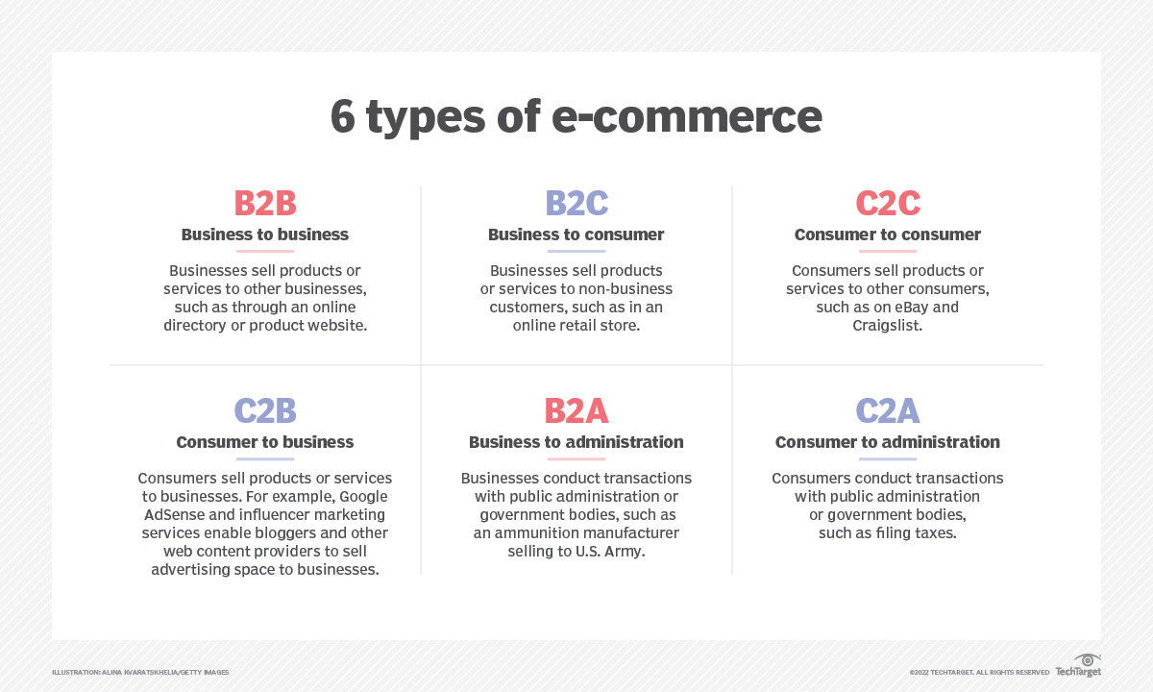

Slide 252
Types of e-commerce
Business-to-business (B2B) e-commerce refers to the electronic exchange of products, services or information between businesses rather than between businesses and consumers. Examples include online directories and product and supply exchange websites that let businesses search for products, services and information and initiate transactions through e-procurement interfaces. A Forrester report published in 2018 predicted that by 2023, B2B e-commerce will reach $1.8 trillion dollars and account for 17% of U.S. B2B sales.
Business-to-consumer (B2C) is the retail part of e-commerce on the internet. It is when businesses sell products, services or information directly to consumers. The term was popular during the dot-com boom of the late 1990s, when online retailers and sellers of goods were a novelty.
Today, there are innumerable virtual stores and malls on the internet selling all types of consumer goods. Amazon is the most recognized example of these sites. It dominates the B2C market.

Slide 253
Consumer-to-business (C2B) is a type of e-commerce in which consumers make their products and services available online for companies to bid on and purchase. This is the opposite of the traditional commerce model of B2C.
A popular example of a C2B platform is a market that sells royalty-free photographs, images, media and design elements, such as iStock. Another example would be a job board.
Business-to-administration (B2A) refers to transactions conducted online between companies and public administration or government bodies. Many branches of government are dependent on various types of e-services or products. These products and services often pertain to legal documents, registers, social security, fiscal data and employment. Businesses can supply these electronically. B2A services have grown considerably in recent years as investments have been made in e-government capabilities.

Slide 254
Consumer-to-consumer (C2C) is a type of e-commerce in which consumers trade products, services and information with each other online. These transactions are generally conducted through a third party that provides an online platform on which the transactions are carried out.
Online auctions and classified advertisements are two examples of C2C platforms. EBay and Craigslist are two well-known examples of these platforms. Because eBay is a business, this form of e-commerce could also be called C2B2C -- consumer-to-business-to-consumer. Platforms like Facebook marketplace and Depop -- a fashion reselling platform -- also enable C2C transactions.
(m-commerce) refers to online sales transactions using mobile devices, such as smartphones and tablets. It includes mobile shopping, banking and payments. Mobile chatbots facilitate m-commerce, letting consumers complete transactions via voice or text conversations.

Slide 255
Consumer-to-administration (C2A) refers to transactions conducted online between consumers and public administration or government bodies. The government rarely buys products or services from individuals, but individuals frequently use electronic means in the following areas:
Social security. Distributing information and making payments.
Taxes. Filing tax returns and making payments.
Health. Making appointments, providing test results and information about health conditions, and making health services payments.
Mobile e-commerce

Slide 256
Mobile Commerce
Mobile commerce, also known as m-commerce, involves using wireless handheld devices like cell phones and tablets to conduct commercial transactions online, including the purchase and sale of products, online banking, and paying bills.

Slide 257
M-commerce examples and types
Broken into three main categories (mobile shopping, mobile payments, and mobile banking), the highest growth areas for m-commerce are:
In-app purchasing (such as buying clothing items via a retail app)
Mobile banking
Virtual marketplace apps like Amazon
Digital wallets like Apple Pay, Android Pay, and Samsung Pay
Mobile ticketing

Slide 258
Key m-commerce areas include:
Browsing and buying: Similar to an e-commerce flow on a desktop, this form of m-commerce involves the user browsing apps, clicking around mobile websites, and making purchases. This typically occurs via dedicated apps, but can also take place as a ‘social commerce’ purchase, with social media platforms including TikTok, Instagram and Snapchat offering purchasing options in-app.
Convenience purchases: Many of the purchases that take place on mobile aren’t retail-related, and m-commerce is not restricted to ‘shopping’ per se. These purchases include ordering food or grocery deliveries, and booking taxis or ride-sharing.
Mobile app payments and wallet payments: There are various ways to actually make an m-commerce purchase, and digital wallets are growing in use. Instead of inputting credit card details to each individual app, a user’s digital wallet can be loaded (as a popup/overlay) and the purchase can be made with a single click or by simply using a thumbprint.
Digital content (purchasing and renting): Subscriptions apps are extremely popular on mobile, most commonly with music and video (think Netflix and Spotify). Users pay a subscription fee and can then access an entire library of content from their mobile app.

Slide 259
Mobile Computing
Mobile Computing is a technology that provides an environment that enables users to transmit data from one device to another device without the use of any physical link or cables
In other words, you can say that mobile computing allows transmission of data, voice and video via a computer or any other wireless-enabled device without being connected to a fixed physical link. In this technology, data transmission is done wirelessly with the help of wireless devices such as mobiles, laptops etc.

Slide 260
The concept of Mobile Computing can be divided into three parts:
Mobile Communication
Mobile Hardware
Mobile Software
Mobile communication can be divided in the following four types:
Fixed and Wired
Fixed and Wireless
Mobile and Wired
Mobile and Wireless

Slide 261
Mobile Hardware
Mobile hardware consists of mobile devices or device components that can be used to receive or access the service of mobility. Examples of mobile hardware can be smartphones, laptops, portable PCs, tablet PCs, Personal Digital Assistants, etc.
Mobile Software
Mobile software is a program that runs on mobile hardware. This is designed to deal capably with the characteristics and requirements of mobile applications. This is the operating system for the appliance of mobile devices. In other words, you can say it the heart of the mobile systems. This is an essential component that operates the mobile device.

Slide 262
Applications of Mobile Computing
Web or Internet access.
Global Position System (GPS).
Emergency services.
Entertainment services.
Educational services.

Slide 263
mobile analytics
In a nutshell, mobile app analytics is a way to gather data from app users to show user behavior and track app performance. If you have questions about your users, you need to dive into analytics.
Mobile app analytics platforms are tools used to track, observe, and support the evaluation of user behavior and experience.
Here are some common situations for product managers where mobile app analytics can help uncover solutions:

Slide 264
Which screens are most engaged with and where do users spend most of their time?
Are my users flowing through my app as intended, or are there areas of friction?
Which screens in my app have the highest crash rate?
What are the most common interactions (gestures) across my app?
Which features seem confusing to users?

Slide 265
Some more advantages of using an app analytics platform: -
Gain data-driven insights. Apps with high retention rates usually experience better user engagement, which means more customers and revenue. Using an analytics tool to get this data frees up time for mobile teams to focus on delivering user-focused product updates.
Collect accurate data. Without performing or checking user feedback or interviews, app analytics platforms uncover the why behind user behavior and experience with detailed, reliable data.
Helps customize apps. Having this data means being able to easier identify issues more through features like session replay and heatmaps to fix obstacles in the user journey. This way product managers have the ability to customize the app and become closer to the goal of providing a seamless experience to end-users.
Aligns cross-functional teams. Being able to share session recordings, customizable dashboards, and crash reports means separate teams can quickly gain clarity on issues. For example, with UXCam customer support teams can speak to a customer about an issue, review their session and then share that session with the PM or engineering team to solve.

Slide 266
social media analytics
Social media analytics acquires and evaluates data from different social media platforms such as Facebook, Twitter, Reddit, YouTube, Instagram, and more. Without a social media analytics system, it is difficult to track, monitor, and make sense of the information spread out in comments, posts, shares, and promotions.

Slide 267
social media analytics
Identify market trends
Collect information from different social media channels to analyse customer behaviour and illustrate industry trends.
Gauge customer engagement
Analyse how social media users engage with the marketing material and understand if your campaigns are churning to their full potential. Allow customers to engage with your brand through their questions and other online discussions.
Study the demographics
Social media statistics help businesses analyse which customer demographics support or purchase a product or service. Using this information, marketing specialists can improve or change their strategy.

Slide 268
Detect inefficiencies in the company or products
Monitor the customers’ opinions about your products and services and use these insights to improvise. Know why people like a specific brand and how you can align your other brands accordingly.

Slide 269
Direct benefits of social media analytics
Social media is a powerful tool to boost sales, increase brand awareness and trust, and increase customer satisfaction. The goldmine of online information helps you achieve these direct benefits –
Measure social media ROI
Agencies can directly showcase their value to brands. One of the direct value outputs of social media analytics is the ROI of campaigns. Brands can use the ROI analysis to further invest in targeting more customers and bringing them to the website.
Refine your social media strategy
Use analytics to understand which marketing strategies are working better than the others. Focus your efforts and money on those that deliver actual value and improvise on those that do no

Slide 270
Get a better understanding of the audience
Most people have a digital footprint, and that provides valuable information about your needs and preferences. Marketers can use this information to engage with the audience in real-time.
Benchmark against competitors
Use social media analytics to identify competitors. Know what they do well and where their social media gaps are. Using this information, you can align your campaigns for greater competitive advantage.

Slide 271
Hive in Hadoop
No one can better explain what Hive in Hadoop is than the creators of Hive themselves: "The Apache Hive™ data warehouse software facilitates reading, writing, and managing large datasets residing in distributed storage using SQL. The structure can be projected onto data already in storage."
In other words, Hive is an open-source system that processes structured data in Hadoop, residing on top of the latter for summarizing Big Data, as well as facilitating analysis and queries.
Now that we have investigated what is Hive in Hadoop, let’s look at the features and characteristics.

Slide 272
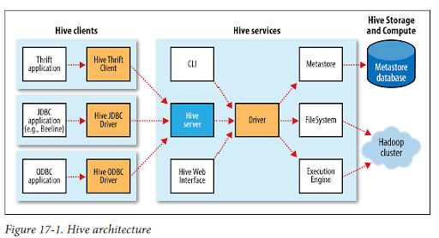

Slide 273
Hive chiefly consists of three core parts:
Hive Clients: Hive offers a variety of drivers designed for communication with different applications. For example, Hive provides Thrift clients for Thrift-based applications. These clients and drivers then communicate with the Hive server, which falls under Hive services.
Hive Services: Hive services perform client interactions with Hive. For example, if a client wants to perform a query, it must talk with Hive services.
Hive Storage and Computing: Hive services such as file system, job client, and meta store then communicates with Hive storage and stores things like metadata table information and query results.

Slide 274
Hive's Features
Hive is designed for querying and managing only structured data stored in tables
Hive is scalable, fast, and uses familiar concepts
Schema gets stored in a database, while processed data goes into a Hadoop Distributed File System (HDFS)
Tables and databases get created first; then data gets loaded into the proper tables
Hive supports four file formats: ORC, SEQUENCEFILE, RCFILE (Record Columnar File), and TEXTFILE

Slide 275
Hive uses an SQL-inspired language, sparing the user from dealing with the complexity of MapReduce programming. It makes learning more accessible by utilizing familiar concepts found in relational databases, such as columns, tables, rows, and schema, etc.
The most significant difference between the Hive Query Language (HQL) and SQL is that Hive executes queries on Hadoop's infrastructure instead of on a traditional database
Since Hadoop's programming works on flat files, Hive uses directory structures to "partition" data, improving performance on specific queries
Hive supports partition and buckets for fast and simple data retrieval
Hive supports custom user-defined functions (UDF) for tasks like data cleansing and filtering. Hive UDFs can be defined according to programmers' requirements

Slide 276
Hive - Data Types
Column Types
Literals
Null Values
Complex Types

Slide 277
Integral Types
Integer type data can be specified using integral data types, INT. When the data range exceeds the range of INT, you need to use BIGINT and if the data range is smaller than the INT, you use SMALLINT. TINYINT is smaller than SMALLINT.

Slide 278
Type | Postfix | Example
TINYINT | Y | 10Y
SMALLINT | S | 10S
INT | - | 10
BIGINT | L | 10L

Slide 279
String Types
String type data types can be specified using single quotes (' ') or double quotes (" "). It contains two data types: VARCHAR and CHAR. Hive follows C-types escape characters.
Timestamp
It supports traditional UNIX timestamp with optional nanosecond precision. It supports java.sql.Timestamp format “YYYY-MM-DD HH:MM:SS.fffffffff” and format “yyyy-mm-dd hh:mm:ss.ffffffffff”.
Dates
DATE values are described in year/month/day format in the form {{YYYY-MM-DD}}.

Slide 280
Decimals
The DECIMAL type in Hive is as same as Big Decimal format of Java. It is used for representing immutable arbitrary precision. The syntax and example is as follows:
DECIMAL(precision, scale)
decimal(10,0)

Slide 281
Literals
The following literals are used in Hive:
Floating Point Types
Floating point types are nothing but numbers with decimal points. Generally, this type of data is composed of DOUBLE data type.
Decimal Type
Decimal type data is nothing but floating point value with higher range than DOUBLE data type. The range of decimal type is approximately -10⁻³⁰⁸ to 10³⁰⁸.

Slide 282
Null Value
Missing values are represented by the special value NULL.
Complex Types
The Hive complex data types are as follows:
Arrays
Arrays in Hive are used the same way they are used in Java.
Syntax: ARRAY<data_type>
Maps
Maps in Hive are similar to Java Maps.
Syntax: MAP<primitive_type, data_type>
Structs
Structs in Hive is similar to using complex data with comment.

Slide 283
Hive Query Language
Hive Query Language (HiveQL) is a query language in Apache Hive for processing and analyzing structured data.
It separates users from the complexity of Map Reduce programming. It reuses common concepts from relational databases, such as tables, rows, columns, and schema, to ease learning.
Hive provides a CLI for Hive query writing using Hive Query Language (HiveQL).

Slide 284
Hive Query Language
Hive QL is the HIVE QUERY LANGUAGE
Hive offers no support for row-level inserts, updates, and deletes.
Hive does not support transactions.
Hive adds extensions to provide better performance in the context of Hadoop and to integrate with custom extensions and even external programs.
DDL and DML are the parts of HIVE QL
Data Definition Language (DDL) is used for creating, altering and dropping databases, tables, views, functions and indexes.
Data manipulation language is used to put data into Hive tables and to extract data to the file system and also how to explore and manipulate data with queries, grouping, filtering, joining etc.

Slide 285
Databases in Hive:
The Databases in the Hive is essentially just a catalog or namespace of tables.
They are very useful for larger clusters with multiple teams and users, as a way of avoiding table name
Hive provides commands such as
CREATE DATABASE db name -- to create a database in Hive
USE db name -- To use the database in Hive.
DROP db name -- To delete the database in Hive.
SHOW DATABASE -- to see the list of the DataBase

Slide 286
Tables in Hive:
Hive table is logically made up of the data being stored and the associated metadata describing the layout of the data in the table.
The data typically resides in HDFS, although it may reside on any Hadoop file system including the local file system.
Hive stores the metadata in a relational database and not in HDFS.
The command for creating a table in Hive is
have>CREATE TABLE EMP (empid int, ename string, esal double)
ROW FORMAT DELIMITED FIELDS TERMINATED By ‘t’ LINES TERMINATED by ‘n’ STORED AS TEXT FILE;

